Slide 1
Week 34 Chemistry
Gas Laws, Unit 10 Assessment, Energy

Slide 2
Warm Up: 5 Minutes
Write the Learning Target
Stay in your own seat
You should be working SILENTLY
The reaction of hydrogen and oxygen to form water is shown below:
2 H₂ + O₂ → 2 H₂O
10.5L oxygen gas is reacted at a pressure of 63.4 mmHg and a temperature of 98 ºC. How many moles of water are formed? [Use R = 62.4]

Slide 3
Agenda
Warm Up: 7 Minutes
Science Next Year: 5 Minutes
Gas Law Stoichiometry Video: 14 Minutes
Guided Practice: 12 Minutes
Independent Practice: 13 Minutes
Closing: 2 Minutes

Slide 4
What should you take for science next year?
Most of You: Physics
Some of You: Pre-AP Physics (I will email you and we can talk about this)
Very few: AP Chemistry and Pre-AP Physics

Slide 5
Gas Law Stoichiometry – Part 2 Video
Go to shschem.weebly.com (our class website)
  Bookmark this if you haven’t done so already!!!
Hover over my page:
  Mr. Ghosh → Video Lessons
Watch video for May 5
Take notes on your handout

Slide 6
Example 1
The reaction of zinc and hydrochloric acid is shown below:
Zn + 2 HCl → ZnCl₂ + H₂
If 4.7 moles of zinc are reacted at a pressure of 3.97 atm and a temperature of 145 ºC, how many liters of hydrogen gas are formed?

Slide 7
Example 2
How many liters of ammonia (NH₃) are required to react with 7.02 moles of Mercury (II) Chloride at 270 K and 64 kPa?
HgCl₂ + 2 NH₃ → NH₄Cl + Hg(NH₂)Cl

Slide 8
Guided Practice
Take 22 seconds to study the problem.
When Mr. Ghosh indicates that you can talk, take 78 seconds to work the problem with your teammates.
When Mr. Ghosh says SWAG, be ready to share and explain your answers.

Slide 9
Guided Practice #1
How many liters of carbon dioxide are formed when 3.5 moles of nitric acid (HNO₃) reacts at 78 kPa and 50 ºC?
HNO₃ + NaHCO₃ → NaNO₃ + CO₂ + H₂O

Slide 10
Guided Practice #2
The combustion of octane is shown below:
2 C₈H₁₈ + 25 O₂ → 16 CO₂ + 18 H₂O
If 36L of carbon dioxide are formed at a pressure of 466 mmHg and a temperature of 907 K, how many moles of octane reacted?

Slide 11
Independent Practice
Its time to see if you truly understand Gas Law Stoichiometry. ..

Slide 12
Closing
How can you calculate volume for a gas in a chemical reaction?

Slide 13
Warm Up: 4 Minutes
Write the Learning Target
Stay in your own seat
You should be working SILENTLY
The reaction of hydrogen and oxygen to form water is shown below:
2 H₂ + O₂ → 2 H₂O
4.1 moles of H₂ are reacted with excess oxygen at 760 mmHg and 408 K. How many liters of H₂O are formed? [Use R = 62.4]

Slide 14
Agenda
Warm Up: 7 Minutes
Dalton’s Law Video: 15 Minutes
Guided Practice: 13 Minutes
Independent Practice: 15 Minutes
Closing: 3 Minutes

Slide 15
Dalton’s Law Video
Go to shschem.weebly.com (our class website)
  Bookmark this if you haven’t done so already!!!
Hover over my page:
  Mr. Ghosh → Video Lessons
Watch video for May 6
Take notes on your handout

Slide 16
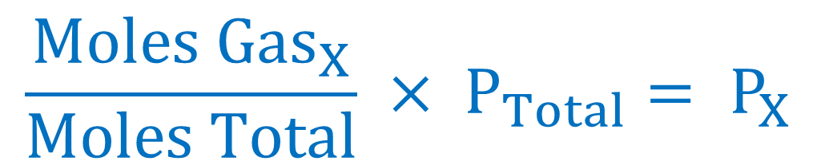
Dalton’s Law of Partial Pressures
The sum of the partial pressures is equal to the total pressure
P_{Total} = P_{A} + P_{B} + P_{C} + …
$$\frac{{Moles Gas}_{X}}{Moles Total} × P_{Total}= P_{X}$$

Slide 17
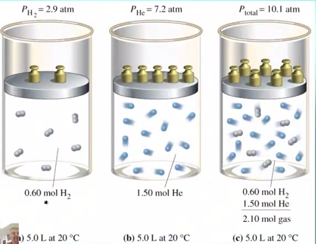

Slide 18
Example 1
A certain sample of gas is composed of oxygen, nitrogen, and carbon dioxide. The partial pressures of each of the gases is shown in the table below:
Based on the partial pressures, what is the total pressure of the gas?
Gas | Partial Pressure (P_{x})
Oxygen | 1.66 atm
Nitrogen | 3.08 atm
Carbon Dioxide | 7.96 atm

Slide 19
Example 2
Air is made of 21% oxygen and 79% nitrogen. If the total pressure of air is 610 mmHg, calculate the partial pressure for each gas.

Slide 20
Example 3
What is the partial pressure of nitrogen in a container that holds 2.5 moles of oxygen, 3.7 moles of nitrogen, and 1.9 moles of neon and has a total pressure of 60 atm?

Slide 21
Guided Practice
Take 12 seconds to study the problem.
When Mr. Ghosh indicates that you can talk, take 28 seconds to work the problem with your teammates.
When Mr. Ghosh says SWAG, be ready to share and explain your answers.

Slide 22
Guided Practice #1
The total pressure of the gases in a chamber is 10 kPa. The only three gases present are oxygen, hydrogen, and neon. If the partial pressure of oxygen is 2.3 kPa and the partial pressure of hydrogen is 7.1 kPa, what is the partial pressure of neon?

Slide 23
Guided Practice #2
What is the partial pressure of carbon dioxide in a container that holds 5.5 moles of carbon dioxide, 2.7 moles of nitrogen, and 1.8 mole of hydrogen and has a total pressure of 1000 kPa?

Slide 24
Guided Practice #3
What is the total pressure exerted by a mixture containing two gases if the partial pressure of one gas is 70 torr and the partial pressure of the other gas is 30 torr?

Slide 25
Guided Practice #4
A sealed flask contains a mixture of 1.0 moles N₂ and 2.0 moles O₂. If the total pressure of this gas mixture is 6.0 atm, calculate the partial pressure of each gas.

Slide 26
Independent Practice
Its time to see if you truly understand Dalton’s Law of Partial Pressures

Slide 27
Closing
What is the relationship between moles and the partial pressure?

Slide 28
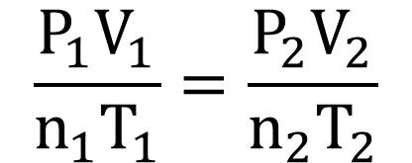
Warm Up: 4 Minutes
Write the Learning Target
Sit in your assigned seat
You should be working SILENTLY
Gas in a balloon is cooled from 75 ºC to 10ºC. If the initial pressure is 1.96 atm, what is the final pressure of the gas?
$$\frac{P_{1}V_{1}}{n_{1}T_{1}}=\frac{P_{2}V_{2}}{n_{2}T_{2}}$$
PV = nRT

Slide 29
Announcement/Reminders
Gas Laws Exam is TOMORROW
Exam is 19 questions long

Slide 30
Reminder!!!
Exam Tomorrow

Slide 31
Agenda
Warm Up- 7 Minutes
Purpose of Review/ Material Covered- 3 Minutes
Expectations for White Board Jeopardy- 3 Minutes
White Board Jeopardy- 37 Minutes
Closing- 3 Minutes

Slide 32
Purpose of Reviewing
Prepare for Assessment 10

Slide 33
Why Prepare?
85%
17
Questions

Slide 34
Material Covered on Assessment 10
Boyle’s Law
Charles Law
G. Lussac’s Law
Combined Gas Law
Ideal Gas Law
Gas Law Stoichiometry
Dalton’s Law of Partial Pressure

Slide 35
White Board Jeopardy
Students will work in groups of 3 to 4 (Team number is on the desk in front of you).
Students will need Dry Erase Board, Marker, Periodic Table, and Calculator.
NOTES are allowed during White Board Jeopardy

Slide 36

White Board Jeopardy
Team #
How to Play???
Write your team number in the upper right hand corner
During the song, you will work the problem shown in your lap INDIVIDUALLY.
At the end of the Jeopardy song, you will talk with your group.
When Mr. Ghosh says “Boards Up” , all students in group must have Identical responses on their Dry Erase Boards that are correct in order to receive FULL CREDIT. Boards that are not up will not be counted.
You may be called on randomly to explain your answer. If I do this and you cannot explain correctly, your team will NOT receive credit.

Slide 37
Scoring and Rules/Expectations
Scoring:
All questions are worth 1 point
Rules/Expectations:
No talking during the Jeopardy song
Must be working individually during the song
No arguing with Mr. Ghosh about scoring
Must be explaining WHY during group work time
Any violations of the rules/expectations will result in your team losing a point

Slide 38
Prizes!
The team that finishes with the most number of points will receive 5% extra credit on the Exam tomorrow.

Slide 39
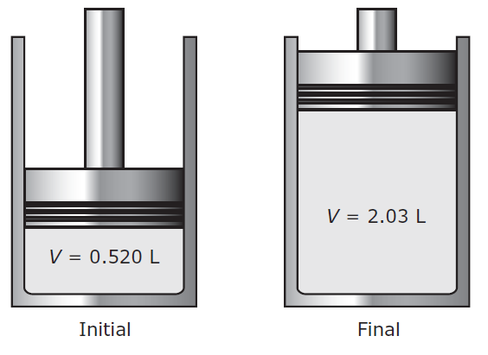

The diagram below shows a gas with an initial pressure of 1500 mm Hg in a cylinder at a constant temperature. The gas expands inside the cylinder and pushes the piston up.
What is the final pressure of the gas after the expansion?

Slide 40
A gas thermometer measures temperature by measuring the pressure of a gas inside a fixed volume container. A thermometer reads a pressure of 310 torr at 0 ºC. What is the temperature (in K) when the thermometer reads a pressure of 453 torr?

Slide 41
The air inside a beach ball is at a temperature of 40 ºC and a pressure of 1.9 atm. If the ball contains 0.645 moles of air, what is its volume?

Slide 42
When subjected to an electric current, water decomposes to hydrogen and oxygen gas.
2 H₂O → 2 H₂ + O₂
If 20.0 L of water are decomposed, how many grams of oxygen gas are produced at 60°C and 95 mmHg?

Slide 43
Suppose 3.50 L of a gas is known to contain 0.135 mol at 30 ºC. If the amount of the gas is increased to 0.650 mol and the temperature increases to 400 K, what will the new volume of the gas be?

Slide 44
Carbon monoxide reacts with nitrogen monoxide to produce nitrogen gas and carbon dioxide.
2 CO + 2 NO → N₂ + 2 CO₂
If 4.00 moles NO is reacted completely with carbon monoxide at 300 kPa and 500 K, how many liters of nitrogen gas will be produced?

Slide 45
Gas in a balloon is heated from 200 K to 30ºC. If the initial volume is 1.75 L, what is the final volume of the gas?

Slide 46
A specific gas mixture is 65% nitrogen, 22% oxygen, 11% argon, and 2% other gases. If the total pressure is 85 kPa, what is the partial pressure of nitrogen?

Slide 47
It is not safe to put aerosol containers in a campfire because the pressure inside the canisters gets very high, leading to explosions. If you have a 5.0 L canister that holds 12 moles of gas at 600 ºC, what is the pressure (in atm) inside the canister?

Slide 48
What is the partial pressure of carbon dioxide in a container that holds 3 moles of carbon dioxide, 7 moles of nitrogen, and 2 moles of hydrogen and has a total pressure of 11.4 atm?

Slide 49
The total pressure of the gases in a chamber is 17 atm. The only three gases present are hydrogen, methane, and krypton. If the partial pressure of hydrogen is 4.4 kPa and the partial pressure of methane is 1.96 kPa, what is the partial pressure of krypton?

Slide 50
Closing
Good Luck
Studying

Slide 51
Warm Up: 4 Minutes
Write the Learning Target
Stay in your own seat
You should be working SILENTLY
Write three things that you could do once you get your test to ensure that you’re successful.
When you’re done, look through your notes and worksheets to prepare for the assessment.

Slide 52
Agenda
Warm Up: 5 Minutes
Goals/ Expectations for Assessment: 3 Minutes
Assessment: 42 Minutes
Closing: 3 Minutes

Slide 53
Why Prepare?
What is Mastery?
85%
17
Questions

Slide 54
Expectations for Assessment
Clear your desk of everything except a....
Number 2 Pencil
Scantron
Calculator
Backpacks and binders on the floor

Slide 55
Testing Tips
Read the problem and answer choices CAREFULLY
If you don’t know the answer, make sure you at least take a guess
Guessing on questions you don’t know can only help you!
Bubble your answers completely (scantron and test booklet)
Periodic Table/Formulas are in the test packet

Slide 56
Testing Rules
Students will remain SILENT for the duration of the test. Even if you are done, YOU CANNOT TALK or MAKE OTHER NOISES
Keep your eyes on YOUR OWN PAPER
Raise your hand if you have a question
Failure to follow the testing rules will result in your test being taken. You will then receive a ZERO and a dean referral.

Slide 57
Good Luck!

Slide 58
Closing
How was your assessment?
What could you have done differently?

Slide 59
Warm Up: 4 Minutes
Write the Learning Target
Stay in your own seat
You should be working SILENTLY
What is energy? Use at least 3 sentences to explain your thoughts
[Turn in your warmup sheet today]

Slide 60
Agenda
Warm Up: 7 Minutes
Energy Activity: 35 Minutes
Closing: 3 Minutes

Slide 61
Activity directions
All instructions are on your handout
Follow instructions for each section
Turn in completed handout to bin at the end of class (all problems will be graded)
For a Spanish version of the BrainPOP video:
http://tinyurl.com/lhnhmuw

Slide 62
Closing
What are the four types of energy?
A ball is moving through the air. What type of energy does it have?

