Slide 1
Week 31 Chemistry
pH Calculation, Strengths of Acids/Bases, Dissociation

Slide 2
Warm Up: 4 Minutes
Write the Learning Target
Stay in your own seat
You should be working SILENTLY
Classify the following reaction as Acid-Base, Oxidation-Reduction, or Precipitation.
NaCl (aq) + AgNO₃ (aq) → NaNO₃ (aq) + AgCl (s)
Jennifer has two solutions. One has a pH of 6, the other a pH of 12. Which one has the higher OH⁻ concentration?

Slide 3
Agenda
Seating Chart: 3 minutes
Warm Up: 6 Minutes
pH Video: 15 Minutes
Guided Practice: 12 Minutes
Independent Practice: 14 Minutes
Closing: 3 Minutes

Slide 4
pH Calculation-Part 1 Video
Go to shschem.weebly.com (our class website)
  Bookmark this if you haven’t done so already!!!
Hover over my page:
  Mr. Ghosh → Video Lessons
Watch video for April 14
Take notes on your handout

Slide 5
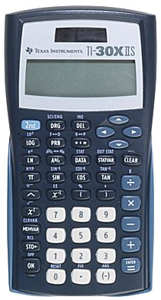
What will you need for this lesson?
Calculator

Slide 6
Let’s Review…
What does it mean if a solution has a high H⁺ concentration?
What about a low H⁺ concentration?

Slide 7
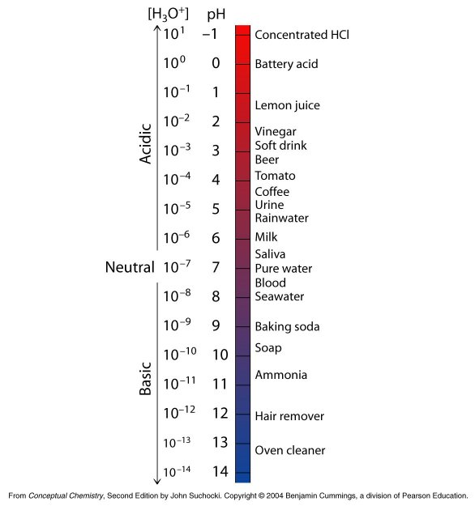
Lower pH, More H+ ions
pH Scale
(More Acidic)
Scale runs from 0 to 14
Higher pH, More OH- ions (less H⁺ ions)
(More Basic)

Slide 8
pH
tells you the relative concentration of H⁺ ions in a solution
pH = -log [H⁺]
[H⁺] = Concentration of H⁺

Slide 9
How do we put this in our calculator?
pH = -log[H⁺]

Slide 10
Check Point
What is the formula for calculating pH?
pH = -log[H⁺]

Slide 11
Example 1:
What is the pH of a solution of HCl with a hydrogen ion concentration of 1.0 x 10⁻⁸ M?

Slide 12
Example 2:
What is the pH of a solution of HNO₃ with a hydrogen ion concentration of 8.3 x 10⁻¹ M?

Slide 13
Example 3:
A student has 10L of HBr solution. It contains 9 moles of H⁺. What is the pH of the solution?

Slide 14
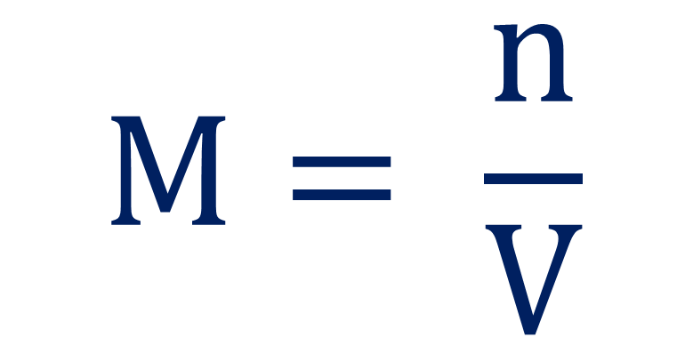
How can we find concentration?
$$M= \frac{n}{V}$$

Slide 15
Example 3:
A student has 10L of HBr solution. It contains 9 moles of H⁺. What is the pH of the solution?

Slide 16
Guided Practice
Take 12 seconds to study the problem.
When Mr. Ghosh indicates that you can talk, take 18 seconds to work the problem with your teammates.
When Mr. Ghosh says SWAG, be ready to share and explain your answers.

Slide 17
Guided Practice #1:
Ignacio was making some ceviche for a party at his house. He needed to use some lemon juice, which had a hydrogen ion concentration of 1.4 x 10⁻² M. What was the pH of the lemon juice?
pH = 1.9

Slide 18
Guided Practice #2:
Michael was working with some Sodium Hydroxide (NaOH) in the lab that had a [H⁺] concentration of 3.50 x 10⁻¹³ M. According to standard lab safety regulations, any substance with a pH greater than 12 is a dangerous base. Would you classify the sodium hydroxide to be a dangerous base? Why or why not?
Yes. pH is 12.5

Slide 19
Guided Practice #3:
Perla went to the dentist for her yearly checkup. Her doctor said to stop drinking highly acidic beverages (pH < 5) since they were bad for her teeth. On a daily basis, Perla drinks each of the following:
Water: [H⁺] = 1.0 x 10⁻⁷ M
Coca-Cola: [H⁺] = 1.6 x 10⁻⁴ M
Milk: [H⁺] = 3.99 x 10⁻⁷ M
Which beverage(s) are highly acidic? How do you know?
Coca Cola. pH < 5

Slide 20
Guided Practice #4:
Jacqueline was making 7L of Carbonic Acid (H₂CO₃) solution. She wanted to make one with a pH of 4.5, but accidentally made a measurement mistake. After an experiment, she found that there were 2.2 x 10⁻³ moles of H⁺ in the solution. What was the actual pH? Is this stronger or weaker acid than the desired pH of 4.5?
Actual pH was 3.5. This is a stronger acid (pH is lower)

Slide 21
Independent Practice

Slide 22
Closing
How do we calculate pH using H⁺ concentration?

Slide 23
Warm Up: 4 Minutes
Write the Learning Target
Stay in your own seat
You should be working SILENTLY
Jorge has 12L of Hydrochloric acid. He finds that there are 6 moles of H⁺ dissolved. What is the concentration of H⁺?
What is the pH of the solution?

Slide 24
Agenda
Warm Up: 7 Minutes
pH Video-Part 2: 15 Minutes
Guided Practice: 13 Minutes
Independent Practice: 15 Minutes
Closing: 3 Minutes

Slide 25
pH Calculation-Part 2 Video
Go to shschem.weebly.com (our class website)
  Bookmark this if you haven’t done so already!!!
Hover over my page:
  Mr. Ghosh → Video Lessons
Watch video for April 15
Take notes on your handout

Slide 26
What will you need for this lesson?
Calculator

Slide 27
Let’s Review…
What does it mean if a solution has a high OH⁻ concentration?
What about a low OH⁻ concentration?

Slide 28
Lower pH, More H+ ions
(less OH⁻ ions)
pH Scale
(More Acidic)
Scale runs from 0 to 14
Higher pH, More OH- ions
(More Basic)

Slide 29
pOH
tells you the relative concentration of OH⁻ ions in a solution
pOH = -log [OH⁻]
[OH⁻] = Concentration of OH⁻

Slide 30
How do we turn this into a pH?
pH = 14 - pOH

Slide 31
Check Point
How do we calculate pOH?
pOH = -log[OH⁻]

Slide 32
Check Point
What is the formula for calculating pH from pOH?
pH = 14 - pOH

Slide 33
Example 1:
What is the pH of a solution of bleach with a hydroxide ion concentration of 1.0 x 10⁻⁶ M?

Slide 34
Example 2:
What is the pH of a solution of NaOH with a hydroxide ion concentration of 4.7 x 10⁻¹ M?

Slide 35
Example 3:
What is the pH of a solution of Windex with a hydroxide ion concentration of 6.7 x 10⁻⁴ M?

Slide 36
Example 4:
A student has 12L of Ca(OH)₂ solution. It contains 7 moles of OH⁻. What is the pH of the solution?

Slide 37
How can we find concentration?
$$M= \frac{n}{V}$$

Slide 38
Example 4:
A student has 12L of Ca(OH)₂ solution. It contains 7 moles of OH⁻. What is the pH of the solution?

Slide 39
Important!!
Pay attention to whether the problem gives you [H⁺] or [OH⁻]
  If given [H⁺], use pH = -log[H⁺]
  If given [OH⁻], find pOH first (pOH = -log[OH⁻]). Then find pH (pH = 14-pOH)

Slide 40
Guided Practice
Take 17 seconds to read the problem.
When Mr. Ghosh indicates that you can talk, take 28 seconds to work the problem with your teammates.
When Mr. Ghosh says SWAG, be ready to share and explain your answers.

Slide 41
Guided Practice #1:
Chris felt sick after eating 5 pounds of crawfish. Jahogany suggested that he take an antacid, which had a hydroxide ion concentration of 3.60 x 10⁻³ M. What was the pH of the antacid?
pH = 11.6

Slide 42
Guided Practice #2:
Joana was working with some Nitric Acid (HNO₃) in the lab that had an [OH⁻] concentration of 3.50 x 10⁻¹³ M. According to standard lab safety regulations, any substance with a pH less than 2 is a dangerous acid. Would you classify the nitric acid to be a dangerous acid? Why or why not?
Yes. pH is 1.54

Slide 43
Guided Practice #3:
Mr. Moore went to the doctor for his yearly checkup. His doctor said that he needed to have an antacid to help control stomach acidity. The three antacid choices were as follows:
Tums: [OH⁻] = 1.3 x 10⁻⁴ M
Rolaids: [H⁺] = 5.6 x 10⁻¹¹ M
Mylanta: [OH⁻] = 7.2 x 10⁻⁴ M
What was the pH of each antacid? Which antacid had the highest pH?
Tums: 10.1, Rolaids: 10.3, Mylanta: 10.9
Mylanta has the highest pH

Slide 44
Guided Practice #4:
Jocelyn needed to clean out her sink at home. She decided to use Drano, a common cleaner containing sodium hydroxide (NaOH). Since the Drano from the store was too strong, she wanted to dilute it to a pH of 13. After diluting the Drano, she found that there were 1.9 x 10⁻³ moles of OH⁻ in 1.4L solution. What was the actual pH? Is this a stronger or weaker base than the desired pH of 13?
Actual pH was 11.1. This is a weaker base (pH is lower)

Slide 45
Independent Practice

Slide 46
Closing
How do we calculate pH using OH⁻ concentration?

Slide 47
Warm Up: 4 Minutes
Write the Learning Target
Stay in your own seat
You should be working SILENTLY
Alexey has 4.15L of Sodium Hydroxide. He finds that there are 2.68 moles of OH⁻ dissolved. What is the concentration of OH⁻?
What is the pOH of the solution?
What is the pH of the solution?

Slide 48
Agenda
Warm Up: 7 Minutes
Advanced pH Calculations Video: 15 Minutes
Guided Practice: 13 Minutes
Independent Practice: 15 Minutes
Closing: 3 Minutes

Slide 49
Advanced pH Calculations Video
Go to shschem.weebly.com (our class website)
  Bookmark this if you haven’t done so already!!!
Hover over my page:
  Mr. Ghosh → Video Lessons
Watch video for April 16
Take notes on your handout

Slide 50
What will you need for this lesson?
Calculator

Slide 51
Let’s go one step further…
We’ve learned how to calculate pH and pOH from [H⁺] and [OH⁻]
How can we go backwards to find [H⁺] and [OH⁻] from pH and pOH?

Slide 52

[H⁺]
Concentration of Hydrogen Ions
$\left[H^{+}\right]= {10}^{−pH}$

Slide 53

[OH⁻]
Concentration of Hydroxide Ions
$\left[{OH}^{−}\right]= {10}^{−pOH}$

Slide 54
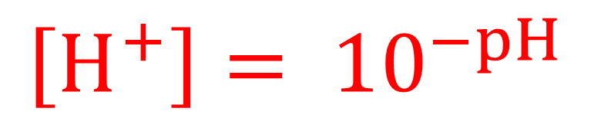
Check Point
How do we calculate [H⁺]?
$$\left[H^{+}\right]= {10}^{−pH}$$

Slide 55
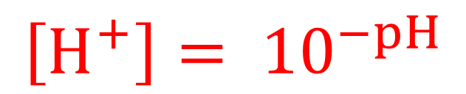
How do we put this in our calculator?
$$\left[H^{+}\right]= {10}^{−pH}$$

Slide 56
Example 1:
What is the hydrogen ion concentration for a solution of pH 3.72?

Slide 57
Example 2:
What is the hydroxide ion concentration for a solution of pOH 4.58?

Slide 58
Example 3:
What is the [OH⁻] for a solution of pH 6.01?

Slide 59
Example 4:
What is the [H⁺] for a solution of pOH 9.47?

Slide 60
Guided Practice
Take 17 seconds to study the problem.
When Mr. Ghosh indicates that you can talk, take 48 seconds to work the problem with your teammates.
When Mr. Ghosh says SWAG, be ready to share and explain your answers.

Slide 61
Guided Practice #1:
A particular brand of milk has a pH of 6.75. What is [H⁺] for the milk? What is the hydroxide ion concentration?
[H⁺] = 1.78 x 10⁻⁷ M
[OH⁻] = 5.62 x 10⁻⁸ M

Slide 62
Guided Practice #2:
Gatorade is designed to have a pOH of 9.94. What is the hydrogen ion concentration? What is the [OH⁻]?
[H⁺] = 8.71 x 10⁻⁵ M
[OH⁻] = 1.15 x 10⁻¹⁰ M

Slide 63
Guided Practice #3:
When making Coca-Cola, the Atlanta headquarters shoots for a pH of 3.08. However, one particular batch of Coca-Cola was too acidic and actually had a pH of 2.57. What was the actual [H⁺]? What was the actual hydroxide ion concentration?
[H⁺] = 2.69 x 10⁻³ M
[OH⁻] = 3.72 x 10⁻¹² M

Slide 64
Guided Practice #4:
Treetop™ Apple Juice has a pOH of 8.56. What is the hydrogen ion concentration? What is the [OH⁻]?
[H⁺] = 3.63 x 10⁻⁶ M
[OH⁻] = 2.75 x 10⁻⁹ M

Slide 65
Independent Practice

Slide 66
Closing
How do we calculate [OH⁻] using pOH?
How do we calculate [OH⁻] using pH?

Slide 67
Warm Up: 4 Minutes
Write the Learning Target
Stay in your own seat
You should be working SILENTLY
A certain bottle of Fanta has a pH of 3.07. What is the [H⁺] for this bottle?
What is the [OH⁻]?

Slide 68
Agenda
Warm Up: 7 Minutes
Degrees of Dissociation Video: 15 Minutes
Guided Practice: 13 Minutes
Independent Practice: 15 Minutes
Closing: 3 Minutes

Slide 69
Degrees of Dissociation Video
Go to shschem.weebly.com (our class website)
  Bookmark this if you haven’t done so already!!!
Hover over my page:
  Mr. Ghosh → Video Lessons
Watch video for April 17
Take notes on your handout

Slide 70
Are there different types of acids and bases?

Slide 71
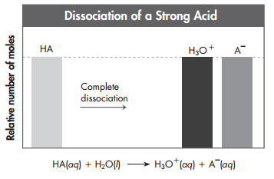
Strong Acids and Bases
Strong Acids and Bases ionize completely (100%) in aqueous solution

Slide 72
The Strong Acids and Bases
There are 7 Strong Acids and 8 Strong Bases (everything else is weak)
Strong Acids
Strong Bases
HCl (Hydrochloric Acid)
LiOH (Lithium Hydroxide)
HBr (Hydrobromic Acid)
NaOH (Sodium Hydroxide)
HI (Hydroiodic Acid)
KOH (Potassium Hydroxide)
H₂SO₄ (Sulfuric Acid)
RbOH (Rubidium Hydroxide)
HNO₃ (Nitric Acid)
CsOH (Cesium Hydroxide)
HClO₃ (Chloric Acid)
Ca(OH)₂ (Calcium Hydroxide)
HClO₄ (Perchloric Acid)
Ba(OH)₂ (Barium Hydroxide)
Sr(OH)₂ (Strontium Hydroxide)

Slide 73
About dissociation…
So strong acids and bases ionize (dissociate) completely in solution.
How do we know how well a weak acid or bases ionizes (dissociates) in solution?

Slide 74
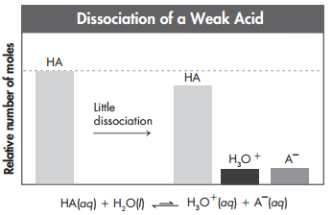
Weak Acids and Bases
Weak Acids and Bases ionize slightly in aqueous solution

Slide 75
Acid Dissociation Constant, K_{a}
Degree of dissociation of a weak acid in water
The larger the K_{a}, the stronger the acid (dissociates more)
All strong Acids have a K_{a} >1

Slide 76
Base Dissociation Constant, K_{b}
Degree of dissociation of a weak base in water
The larger the K_{b}, the stronger the base (dissociates more)
All strong Bases have a K_{b} > 1

Slide 77
Study Tip
When comparing values for K_{a} or K_{b}, remember to interpret the scientific notation correctly.
Negative exponents indicate values that are smaller than 1
Stronger acids and bases will have less negative exponents (closer to 0) than will weaker acids and bases.
Example:
K_{a} of Acetic Acid is 1.76 x 10⁻⁵
Nitrous Acid is stronger than Acetic Acid
K_{a} of Nitrous Acid is 4.0 x 10⁻⁴

Slide 78
Check Point
Which acid in the table is the weakest?
Acid | Acid Dissociation Constant, K_{a}
Oxalic, H₂C₂O₄ | 5.9 x 10⁻²
Phosphoric Acid, H₃PO₄ | 7.52 x 10⁻³
Formic Acid, HCOOH | 1.77 x 10⁻⁴

Slide 79
Check Point
Mildren was looking up K_{b} values for several bases. They were: 1.6 x 10⁻⁴, 5.3 x 10⁻⁹, and 6.7 x 10⁻². Which base would you expect to be the strongest? Why?
6.7 x 10⁻². It has the largest K_{b} (least negative exponent)

Slide 80
Guided Practice
Take 17 seconds to read the problem.
When Mr. Ghosh indicates that you can talk, take 28 seconds to work the problem with your teammates.
When Mr. Ghosh says SWAG, be ready to share and explain your answers.

Slide 81
Guided Practice #1:
Two bases are compared. One is strong and one is weak. Which one would you expect to have the higher K_{b}? Which one would dissociate more?
The Strong base would have the higher K_{b}.
The Strong base would dissociate more

Slide 82
Guided Practice #2:
A certain acid dissolved in solution ionizes completely. Would you classify it as a strong or weak acid? Why?
Strong Acid. All strong acids and bases ionize completely in solution

Slide 83
Guided Practice #3:
Aristides was looking up K_{a} values for several acids. His findings are shown below:
Which acid would you expect to be the strongest? Why?
Acid | Acid Dissociation Constant, K_{a}
Nitrous Acid, HNO₂ | 4.0 x 10⁻⁴
Hydrazoic Acid, HN₃ | 1.9 x 10⁻⁵
Carbonic Acid, H₂CO₃ | 4.3 x 10⁻⁷
Nitrous Acid. It has the largest K_{a} (least negative exponent)

Slide 84
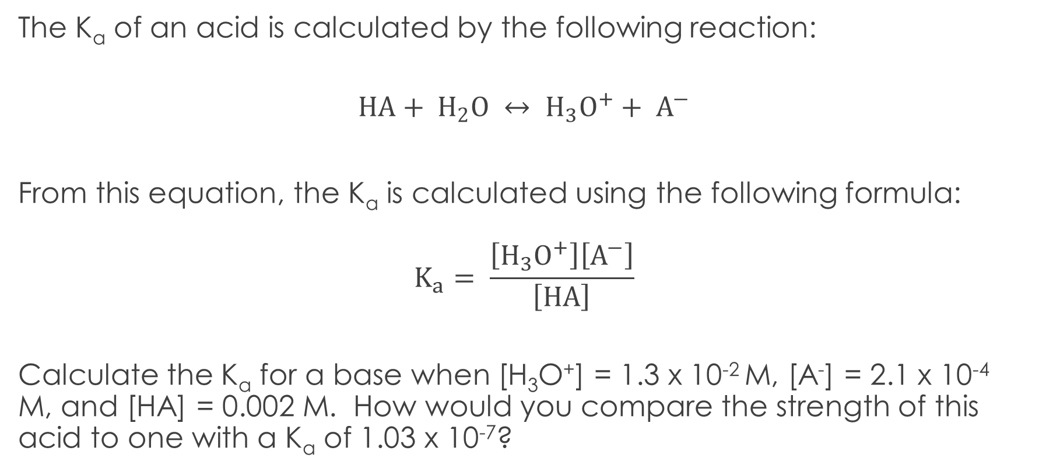
Guided Practice #4:
The K_{a} of an acid is calculated by the following reaction:
$$HA+ H_{2}O ↔ H_{3}O^{+}+ A^{−}$$
From this equation, the K_{a} is calculated using the following formula:
$$K_{a}= \frac{\left[H_{3}O^{+}\right]\left[A^{−}\right]}{\left[HA\right]}$$
Calculate the K_{a} for a base when [H₃O⁺] = 1.3 x 10⁻² M, [A⁻] = 2.1 x 10⁻⁴ M, and [HA] = 0.002 M. How would you compare the strength of this acid to one with a K_{a} of 1.03 x 10⁻⁷?
K_{a} = 1.37 x 10⁻³. It is a stronger acid because the K_{a} is larger

Slide 85
Independent Practice

Slide 86
Closing
What do K_{a} and K_{b} tell us?
Complete the sentence: A _________ K_{a} is a stronger acid

Slide 87
Warm Up: 4 Minutes
Write the Learning Target
Stay in your own seat
You should be working SILENTLY
Three different basic solutions are analyzed from the lab closet. The K_{b} values for each solution is shown below:
  Solution #1: 4.51 x 10⁻⁶
  Solution #2: 3.10 x 10⁻²
  Solution #3: 9.08 x 10⁻⁵
Order the solutions from least basic to most basic

Slide 88
Agenda
Warm Up: 6 Minutes
Acid/Base Quiz: 37 Minutes
Closing: 2 Minutes

Slide 89
Material Covered on Quiz
Properties of Acids and Bases
Arrhenius and Bronsted-Lowry Definitions
Classifying Reactions
pH scale
pH Calculations (pH, pOH, [H⁺], [OH⁻])
Strengths of Acids and Bases

Slide 90
Goal
To demonstrate mastery, we are shooting for
85%

Slide 91
Check Point
What is your goal for this quiz?
85%

Slide 92
Expectations for Quiz
Clear your desk of everything except a....
Writing Utensil
Calculator
Periodic Table
All backpacks and binders on the floor

Slide 93
Expectations
Students will keep eyes on own paper
  Cheating will result in an automatic ZERO
Students will remain SILENT for the duration of the quiz

Slide 94
Good Luck!!

Slide 95
Closing
How was your Quiz Today?
What topics do you feel you still need review on?

