Slide 1
Week 30 Chemistry
Types of Acids, Types of Reactions, pH, Career Planning

Slide 2
Warm Up: 4 Minutes
Write the Learning Target
Stay in your own seat
You should be working SILENTLY
Which of the following compounds would you classify as an acid? Which would be a base?
HCl
Ba(OH)₂
NaOH
H₂SO₄

Slide 3
Agenda
Seating Chart: 3 minutes
Warm Up: 6 Minutes
Acids/Bases Video: 15 Minutes
Guided Practice: 12 Minutes
Independent Practice: 14 Minutes
Closing: 3 Minutes

Slide 4
Acids/Bases Video
Go to shschem.weebly.com (our class website)
Bookmark this if you haven’t done so already!!!
Hover over my page:
Mr. Ghosh → Video Lessons
Watch video for April 7
Take notes on your handout

Slide 5
Acids
vs.
Bases

Slide 6
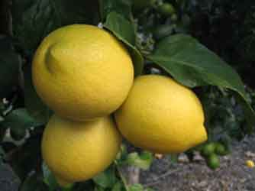
Acids
A compound that is corrosive with a sweet or sour taste that produces hydrogen ions (H⁺) in solutions.

Slide 7
Acids
vs.
Bases

Slide 8
Bases
A compound with a bitter taste and a soapy feel that produces hydroxide, OH⁻ , ions in solution.

Slide 9
Acids
vs.
Bases
Arrhenius
Acid

Slide 10
Arrhenius Acid
Hydrogen-containing compounds that ionize to yield hydrogen ions, (H⁺) or (H₃O ⁺), in aqueous solutions.
HNO₃ + H₂O → H₃O⁺ + NO₃⁻
^{or}
HNO₃ → H⁺ + NO₃⁻

Slide 11
Acids
vs.
Bases
Bronsted-Lowry
Acid
Arrhenius
Acid

Slide 12
Bronsted-Lowry Acid
Hydrogen ion donor.
NH₃ (aq) + H₂O (l) D NH₄⁺ (aq) + OH⁻ (aq)

Slide 13
Check Point
Identify the Bronsted-Lowry Acid in the following reaction.
HNO₃ + H₂O → H₃O⁺ + NO₃⁻

Slide 14
Acids
vs.
Bases
Arrhenius
Base
Arrhenius
Acid
Bronsted-Lowry
Acid

Slide 15
Arrhenius Base
Compounds that ionize to yield hydroxide ions, OH⁻ , in solution.
NaOH (s)→ Na ⁺ (aq) + OH⁻ (aq)

Slide 16
Acids
vs.
Bases
Arrhenius
Base
Bronsted-Lowry
Base
Arrhenius
Acid
Bronsted-Lowry
Acid

Slide 17
Bronsted-Lowry Base
Hydrogen ion acceptor.
NH₃ (aq) + H₂O (l) D NH₄⁺ (aq) + OH⁻ (aq)

Slide 18
Check Point
Identify the Bronsted-Lowry Base in the following reaction.
HNO₃ + H₂O → H₃O⁺ + NO₃⁻

Slide 19
Let’s Review…
Definitions of acids and bases:
 | Arrhenius | Bronsted-Lowry
Acid | Ionize to form H⁺ or H₃O⁺ | Donates hydrogen ion
Base | Ionize to form OH⁻ | Accepts hydrogen ion

Slide 20
Guided Practice
Take 21 seconds to read and think about the questions.
When Mr. Ghosh indicates that you can talk then you are to discuss and justify your thoughts with your teammates for 32 seconds.
When Mr. Ghosh says SWAG, you are to take 76 seconds to compose a response to the question as a group.

Slide 21
Guided Practice #1
HBr (aq) + H₂O (aq) D H₃O⁺ (aq) + Br⁻ (aq)
Which compound functions as the Arrhenius Acid in the forward reaction?
Which compound functions as the Bronsted-Lowry base in the reverse reaction?
HBr
Br⁻

Slide 22
Guided Practice #2
NH₄⁺ (aq) + CN⁻ (aq) D HCN (aq) + NH₃ (aq)
Which compound is the Bronsted-Lowry acid in the forward reaction?
Which compound is the Bronsted-Lowry Base in the reverse reaction?
NH₄⁺
NH₃

Slide 23
Guided Practice #3
Ca(OH)₂ → Ca²⁺ + 2 OH⁻
In the above reaction, why is Ca(OH)₂ classified as an Arrhenius base?
An Arrhenius base is one that ionizes to release OH⁻ ions in solution. Since Ca(OH)₂ splits up into Ca²⁺ and OH⁻, it is an Arrhenius base.

Slide 24
Independent Practice

Slide 25
Closing
How is an Arrhenius acid different from an Arrhenius base?
How is a Bronsted-Lowry acid vs. Bronsted-Lowry Base?

Slide 26
Warm Up: 4 Minutes
Write the Learning Target
Stay in your own seat
You should be working SILENTLY
A reaction is shown below:
NH₃ + H₂O → NH₄⁺ + OH⁻
Which compound in the reaction functions as the Bronsted-Lowry acid? The Bronsted-Lowry Base?

Slide 27
Agenda
Warm Up: 7 Minutes
Redox Reactions Video: 15 Minutes
Guided Practice: 13 Minutes
Independent Practice: 15 Minutes
Closing: 3 Minutes

Slide 28
Redox Reactions Video
Go to shschem.weebly.com (our class website)
Bookmark this if you haven’t done so already!!!
Hover over my page:
Mr. Ghosh → Video Lessons
Watch video for April 8
Take notes on your handout

Slide 29
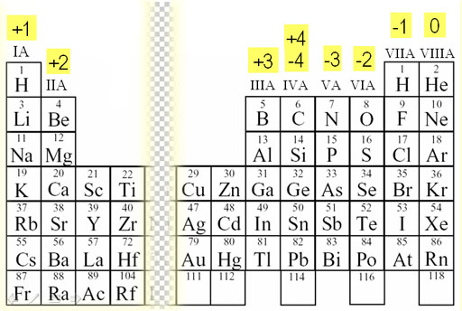
Oxidation Numbers

Slide 30
Oxidation Number Rules
The oxidation numbers of all atoms add up to the charge on the atoms, molecules, or ion.
Example: In CrO₄⁻ , the oxidation number of chromium is +7 and oxygen is -2 because 1(+7) + 4(-2) = -1
The oxidation number of an atom in its elemental form is zero.
Example: For O₂ or Ag, the oxidation number is zero
The oxidation number for hydrogen is usually +1, but if it is bonded to a metal then it is -1.

Slide 31
Redox Reactions
Chemical reactions in which electrons are transferred amongst reactants [AKA oxidation-reduction reactions]

Slide 32
Oxidation
Loss of electrons
[charge become more positive]
Mg(s) + S(s) → MgS(s)
Therefore magnesium is being oxidized
0
+2

Slide 33
Reduction
Gain of electrons
[charge become more negative]
Mg(s) + S(s) → MgS(s)
Therefore sulfur is being reduced
0
-2

Slide 34
Acronym
“LEO the lion goes GER”
Losing Electrons is Oxidation
Gaining Electrons is Reduction

Slide 35
Example 1: Determine what is Oxidized and Reduced in each Reaction
Steps to Success
List the elements in the reaction.
List the charges of the elements on both sides of the reaction.
Use the definition of reduction and oxidation to determine which element is reduced and which is oxidized
ZnCl₂ (aq) + Cu (s) → CuCl₂ (aq) + Zn (s)

Slide 36
Example 2: Determine what is Oxidized and Reduced in each Reaction
CH₄ + 2 O₂ → CO₂ + H₂O

Slide 37
Guided Practice
Take 16 seconds to determine the charge of the elements in the reaction.
When Mr. Ghosh indicates that you can talk take 43 seconds with your teammates to decide which elements are oxidized and which are reduced.
When Mr. Ghosh says SWAG, be ready to share your answers.

Slide 38
Guided Practice #1
Determine what is oxidized and what is reduced in the following reaction:
4Al (s) + 3 O₂ (g) → 2Al₂O₃ (s)

Slide 39
Guided Practice #2
Determine what is oxidized and what is reduced in the following reaction:
2 Cu + 2 H⁺ → 2 Cu⁺ + H₂

Slide 40
Guided Practice #3
Determine what is oxidized and what is reduced in the following reaction:
Br¯ (aq) + MnO₄¯ (aq) ⎯→ Br₂ (l) + Mn²⁺ (aq)

Slide 41
Guided Practice #4
Determine what is oxidized and what is reduced in the following reaction:
2 Na + 2 H₂O → 2 NaOH + H₂

Slide 42
Independent Practice

Slide 43
Closing
Which acronym will help you remember what is getting oxidized and what is getting reduced?

Slide 44
Warm Up: 4 Minutes
Write the Learning Target
Stay in your own seat
You should be working SILENTLY
Zinc metal is reacted with hydrochloric acid to form zinc chloride and hydrogen gas:
Zn + 2 HCl → ZnCl₂ + H₂
Which element was oxidized? Which element was reduced?

Slide 45
Agenda
Warm Up: 7 Minutes
Classifying Reactions Video: 15 Minutes
Guided Practice: 13 Minutes
Independent Practice: 15 Minutes
Closing: 3 Minutes

Slide 46
Classifying Reactions Video
Go to shschem.weebly.com (our class website)
Bookmark this if you haven’t done so already!!!
Hover over my page:
Mr. Ghosh → Video Lessons
Watch video for April 9
Take notes on your handout

Slide 47
Classify Reactions
H₂SO₄ (aq) + Ca(OH)₂(aq)→ CaSO₄ (aq) + H₂O (l)
K₂CrO₄ (aq)+ 2AgNO₃ (aq)→ 2KNO₃ (aq)+ Ag₂CrO₄ (s)
3Mg(s) + N₂ (g)→ Mg₃N₂ (s)

Slide 48
Acid- Base Reaction
Reaction that occurs between an ACID and a BASE
Forms Water and a Salt
2HCl (aq) + Ca(OH)₂(aq)→ CaCl₂ (aq) + 2H₂O (l)
Salt
Water

Slide 49
Oxidation-Reduction Reaction Redox Reaction
Any reaction that causes that involves the exchange of an electron
K(s) + O₂ (g)→ K₂O (s)

Slide 50
Precipitation Reaction
A reaction that occurs when two aqueous solution react and produce a solid precipitate
3NiCl ₂ (aq) + Na₃PO₄(aq)→ Ni₃(PO₄)₂ (s) + 6NaCl (l)

Slide 51
Check Point: Classify Reactions
H₂SO₄ (aq) + Ca(OH)₂(aq)→ CaSO₄ (aq) + H₂O (l)
K₂CrO₄ (aq)+ 2AgNO₃ (aq)→ 2KNO₃ (aq)+ Ag₂CrO₄ (s)
3Mg(s) + N₂ (g)→ Mg₃N₂ (s)

Slide 52
Guided Practice
Take 16 seconds to study the reaction.
When Mr. Ghosh indicates that you can talk, take 24 seconds to classify the reaction with your teammates.
When Mr. Ghosh says SWAG, be ready to share and explain your answers.

Slide 53
Guided Practice #1
Classify the following reaction as acid-base, precipitation, or oxidation-reduction.
Na₂CO₃ (aq) + MgSO₄ (aq) → Na₂SO₄ (aq) + MgCO₃ (s)

Slide 54
Guided Practice #2
Classify the following reaction as acid-base, precipitation, or oxidation-reduction.
HBr (aq) + Ca(OH)₂ (aq) → CaBr₂ (aq) + H₂O (l)

Slide 55
Guided Practice #3
Classify the following reaction as acid-base, precipitation, or oxidation-reduction.
2 Al(s) + 3 NiCl₂ (aq) → 2 AlCl₃ (aq) + 3 Ni (s)

Slide 56
Independent Practice

Slide 57
Closing
How can you distinguish between an acid-base reactions, precipitation reactions, and oxidation-reduction reactions?

Slide 58
Warm Up: 4 Minutes
Write the Learning Target
Stay in your own seat
You should be working SILENTLY
Classify each of the following reactions as acid-base, precipitation, or redox (oxidation-reduction):
Fe(NO₃)₂ (aq) + 2 NaOH (aq) → Fe(OH)₂ (s) + 2 NaNO₃ (aq)
2 HCl (aq) + Ca(OH)₂ (aq) → CaCl₂ (aq) + 2 H₂O (l)

Slide 59
Agenda
Warm Up: 7 Minutes
pH Scale Video: 15 Minutes
Guided Practice: 13 Minutes
Independent Practice: 15 Minutes
Closing: 3 Minutes

Slide 60
pH Scale Video
Go to shschem.weebly.com (our class website)
Bookmark this if you haven’t done so already!!!
Hover over my page:
Mr. Ghosh → Video Lessons
Watch video for April 10
Take notes on your handout

Slide 61
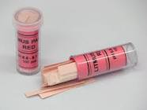
Review
What is one item that we can use to determine whether or not a substance is acidic or basic?

Slide 62
How Else Can You Distinguish an Acid from a Base?
pH

Slide 63
pH
tells you the concentration of H⁺ ions in a solution.
pH = -log [H+]

Slide 64
pOH
tells you the concentration of OH- in a solution.
pOH = -log [OH-]

Slide 65
pH + pOH = 14

Slide 66
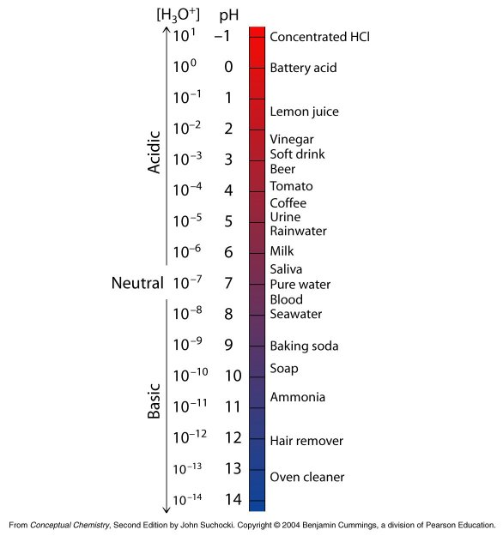
Lower pH, More H+ ions
pH Scale
(More Acidic)
Scale runs from 0 to 14
pH=7, Neutral
Higher pH, More OH- ions
(More Basic)

Slide 67
Summary of pH scale
Solutions with pH values 0-6 are ACIDIC
[solutions with a pH of 0 has more H+ ions making those solutions the strongest acids, solutions with a pH of 6 has the least amount of H+ ions making those solutions the least acidic]
Solutions with pH value of 7 are NEUTRAL
[equal amounts of H+ and OH- ions]
Solutions with pH values 8-14 are BASIC
[solutions with a pH of 8 have the least amount of OH- ions making those solutions the weakest base, solutions with a pH of 14 have the most amount of OH- ions making those the solutions the strongest bases]

Slide 68
Check Point
A solution has a pH of 3. Which ion has a greater concentration , H+ or OH-?
H+

Slide 69
Check Point
A solution has equal amounts of H+ and OH- ions. What is the pH of this solution?
7

Slide 70
Guided Practice: Take 4 minutes to fill in pH scale with the following terms
Acids Bases Least H+ Least OH - Most H+ Most OH- Neutral Produces H+
Produces OH- Strongest acid Strongest base Weakest acid Weakest base
0
7
14

Slide 71
Answers:
Most H+
Most OH-
Least H+
Least OH -
Neutral
Acids
Bases
Produces H+
Produces OH-
0
7
14
Strongest acid
Strongest base
Weakest base
Weakest acid

Slide 72
Guided Practice
Take 16 seconds to study the problem.
When Mr. Ghosh indicates that you can talk, take 32 seconds to work the problem with your teammates.
When Mr. Ghosh says SWAG, be ready to share and explain your answers.

Slide 73
Guided Practice #1
List the following compounds in order of decreasing hydrogen ions (H⁺ ).
Urine (pH- 4.9)
Soap (pH- 9.9)
Blood (pH-7.4)
Soft Drink (pH-2.9)
Soft Drink, Urine, Blood, Soap

Slide 74
Guided Practice #2
List the following compounds in order of increasing hydroxide ions (OH⁻).
Sodium Hydroxide (pH-13)
Hydrochloric Acid (pH- 1)
Bleach (pH-9)
Water (pH-7)
Hydrochloric Acid, Water, Bleach, Sodium Hydroxide

Slide 75
Guided Practice #3
List the following compounds in order of increasing hydrogen ions (H⁺)
Black Coffee (pH-4)
Ammonia (pH-10.5)
Battery Acid (pH-0)
Oven Cleaner (pH- 13.2)
Oven Cleaner, Ammonia, Black Coffee, Battery Acid

Slide 76
Question # | Strongest Acid | Strongest Base
1
2
3

Slide 77
Question # | Strongest Acid | Strongest Base
1 | Soft Drink | Soap
2
3

Slide 78
Question # | Strongest Acid | Strongest Base
1 | Soft Drink | Soap
2 | Hydrochloric Acid | Sodium Hydroxide
3

Slide 79
Question # | Strongest Acid | Strongest Base
1 | Soft Drink | Soap
2 | Hydrochloric Acid | Sodium Hydroxide
3 | Battery Acid | Oven Cleaner

Slide 80
Independent Practice
Answer the following questions in an ESSAY. You must write at least three paragraphs.
What is an acid?
What is a base?
How are these items different in terms of their properties?
How can you distinguish between acids and bases? (reference examples from classes)
[Use the terms: pH, H+, OH-, Litmus Paper,]

Slide 81
Extension Activity
Read pages 582-586.
Write the definition for all bold words.

Slide 82
Closing
What is pH?
How can a substance have a low pH?
How can a substance have a high pH?

