Slide 1
Week 29 Chemistry
Factors affecting Solubility, Unit 8 Assessment, Intro to Acids/Bases

Slide 2
Warm Up: 4 Minutes
Write the Learning Target
Stay in your own seat
You should be working SILENTLY
Wendy has two sugar cubes. She makes two solutions:
  Place whole sugar cube in water
  Crush sugar cube, then put powder in water
Which solution do you think dissolves the sugar fastest? Why?

Slide 3
Announcement
Solutions Exam is on Thursday
Covers everything from Friday’s quiz as well as what we cover today
~30 Questions Long

Slide 4
Agenda
Warm Up [7 minutes]
Solubility Factors Video [18 minutes]
Guided Practice [12 minutes]
Independent Practice [13 minutes]
Closing [3 Minutes]

Slide 5
Solubility Factors Video
Go to shschem.weebly.com (our class website)
  Bookmark this if you haven’t done so already!!!
Hover over my page:
  Mr. Ghosh → Video Lessons
Watch video for March 31
Take notes on your handout

Slide 6
Question…
Can we change how well something dissolves?

Slide 7
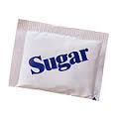
Let’s look at solids first

Slide 8
Ways to increase rate of dissolving (Solids)
Increase Temperature
Example:
Why???
Dissolving sugar in hot tea vs. cold tea
Increasing temperature adds more energy and creates more collisions of solute and solvent (making the solute dissolve faster)

Slide 9
Ways to increase rate of dissolving (Solids)
Increase Movement
Example:
Why???
Stirring vs. Not Stirring
Stirring adds energy and moves the solvent around to dissolve the solute.

Slide 10
Ways to increase rate of dissolving (Solids)
Increase Surface Area
Example:
Why???
(Usually by crushing or smashing)
Sugar cubes vs. Sugar packets
Smaller pieces dissolve more quickly because there are more places to interact between solvent and solute

Slide 11
Check Point
Which would dissolve better, whole candy or crushed candy?
Crushed Candy (Greater Surface Area)

Slide 12
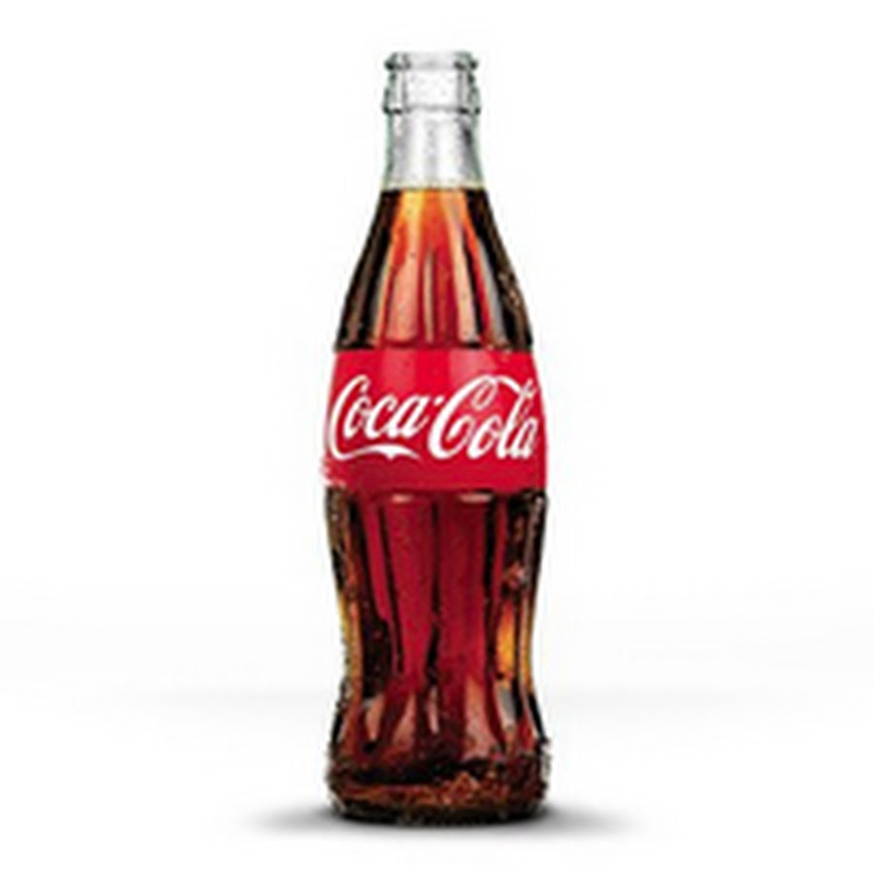
What about Gases?
Did You Know That…
Soda is a gas in solution?
Carbon Dioxide is dissolved in water

Slide 13
Ways to increase rate of dissolving (Gases)
Decrease Temperature
Example:
Why???
Cold soda has more carbonation (fizz) than warm soda
Decreasing temperature decreases energy. Gas escapes more slowly.

Slide 14
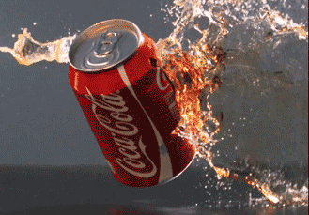

Ways to increase rate of dissolving (Gases)
Decrease Movement
Example:
Why???
Shaking a soda causes it to explode (gas leaves solution)
Less movement = less energy. Gas escapes more slowly

Slide 15
Ways to increase rate of dissolving (Gases)
Increase Pressure
Example:
Why???
Bottled Soda vs. Open Soda
Increased pressure = less room to move. Gas escapes more slowly

Slide 16
Check Point
Which would dissolve better, gas in a cold solution or gas in a warm solution?
Cold Solution (Lower Temperature)

Slide 17
Let’s Review…
To increase the rate of dissolving:
Solids | Gases
Increase Temperature | Decrease Temperature
Increase Movement | Decrease Movement
Increase Surface Area | Increase Pressure

Slide 18
Check Point
Would increasing the temperature of a solid in a liquid increase or decrease the solubility?
Increase

Slide 19
Check Point
Would decreasing movement of a solid in a liquid increase or decrease the solubility?
Decrease

Slide 20
Check Point
Would decreasing pressure of a gas in a liquid increase or decrease the solubility?
Decrease

Slide 21
Guided Practice
Teacher:
  1. Will show the problem on the board
Students:
  Take 19 seconds to read the problem individually
  Take 41 seconds to solve the problem with your shoulder partner
  Be ready to share when Mr. Ghosh says SWAG

Slide 22
Guided Practice #1
A student places a 15g sample of sodium chloride in 25mL of distilled water. Which of the following will most affect the rate of dissolving?
  Increasing the pH of the solution
  Increasing the pressure on the water
  Decreasing the pressure on the water
  Stirring the water as the solid is added

Slide 23
Guided Practice #2
Which of the following sets of actions would most increase the solubility of a gas in water?
  Decrease the pressure and decrease the temperature
  Increase the surface area and increase the temperature
  Decrease the pressure and increase the surface area
  Increase the pressure and decrease the temperature

Slide 24
Guided Practice #3
Which of the following will result in a medicine tablet dissolving fastest in 500 mL of water?
  Increasing the volume of the water.
  Lowering the temperature of the water.
  Crushing the tablet before adding it to the water.
  Adding the untouched tablet to the water without stirring

Slide 25
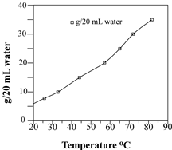
Guided Practice #4
Students in a science class were given various samples of potassium nitrate, KNO₃. The students added the samples to 20 milliliters of water. The water was heated until all of the salt dissolved. The solution was cooled, and the temperature at which the solid appeared was recorded. A solubility graph is shown:
Using the solubility graph, which effect does temperature have on the solubility of KNO₃?
  As the temperature increases, the solubility of KNO₃ increases.
  As the temperature increases, the solubility of KNO₃ decreases.
  As the temperature decreases, the solubility of KNO₃ increases.
  As the temperature stays constant, the solubility of KNO₃ increases.

Slide 26
Independent Practice
Take some time to practice applying your knowledge of solubility factors
85%
Practice makes Perfect

Slide 27
Closing
What factors affect the solubility of both gases and solids? How do they affect the solubility of gases and solids?
Which factors affect just gases and how?
Which factors affect just solids and how?

Slide 28
Warm Up: 4 Minutes
Write the Learning Target
Stay in your own seat
You should be working SILENTLY
Two solutions of solid Potassium Chlorate (KClO₃) are made. One is at 75ºC, the other at 25 ºC. Which solution would you expect to dissolve the solute faster? Why?

Slide 29
Agenda
Warm Up [7 minutes]
Gizmo Expectations [4 minutes]
Solubility Factors Gizmo [40 minutes]
Closing [2 Minutes]

Slide 30
Expectations
All students will remain in their seats at all times
Students will work with their shoulder partner or independently
Students will raise hand (not call out) if they need help

Slide 31
Warning!
If any students are not following expectations, the entire class will stop the activity.

Slide 32
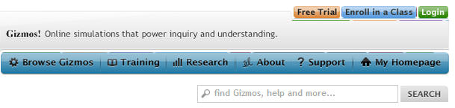
Log in to Gizmo
Go to explorelearning.com
Login to your account

Slide 33
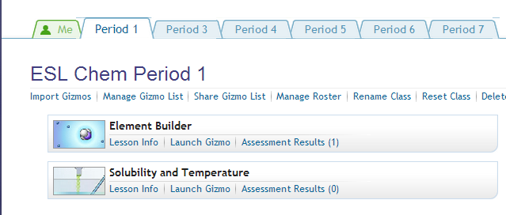
Begin Gizmo
Once you are logged in, click “Launch Gizmo” button for Solubility and Temperature.

Slide 34
Independent Practice
Finish the gizmo questions
85%
Practice makes Perfect

Slide 35
Closing
What factors affect the solubility of both gases and solids? How do they affect the solubility of gases and solids?
Which factors affect just gases and how?
Which factors affect just solids and how?

Slide 36
Warm Up: 4 Minutes
Write the Learning Target
Sit in your assigned seat
You should be working SILENTLY
Write whether each of the following actions is likely to increase (I) or decrease (D) the solubility of a solid or gas.
 | Solid | Gas
Increase temperature
Increase pressure
Decrease movement
Decrease surface area

Slide 37
Announcement/Reminders
Friday’s quiz solutions are online
Solutions Exam is TOMORROW
Exam is 30 questions long, 2 extra credit problems

Slide 38
Reminder!!!
Exam Tomorrow

Slide 39
Agenda
Warm Up- 7 Minutes
Purpose of Review/ Material Covered- 3 Minutes
Expectations for White Board Jeopardy- 3 Minutes
White Board Jeopardy- 37 Minutes
Closing- 3 Minutes

Slide 40
Purpose of Reviewing
Prepare for Assessment 8

Slide 41
Why Prepare?
85%
26
Questions

Slide 42
Material Covered on Assessment 8
Properties of Water
Solubility Rules
Molarity
Dilutions
Types of Solutions
Solubility Curves
Factors affecting Solubility

Slide 43
White Board Jeopardy
Students will work in groups of 3 to 4 (Team number is on the desk in front of you).
Students will need Dry Erase Board, Marker, Periodic Table, Eraser, and Calculator.
NOTES are allowed during White Board Jeopardy

Slide 44

White Board Jeopardy
Team #
How to Play???
Write your team number in the upper right hand corner
During the song, you will work the problem shown in your lap INDIVIDUALLY.
At the end of the Jeopardy song, you will talk with your group.
When Mr. Ghosh says “Boards Up” , all students in group must have Identical responses on their Dry Erase Boards that are correct in order to receive FULL CREDIT. Boards that are not up will not be counted.
You may be called on randomly to explain your answer. If I do this and you cannot explain correctly, your team will NOT receive credit.

Slide 45
Scoring and Rules/Expectations
Scoring:
All questions are worth 1 point
Rules/Expectations:
No talking during the Jeopardy song
Must be working individually during the song
No arguing with Mr. Ghosh about scoring
Must be explaining WHY during group work time
Any violations of the rules/expectations will result in your team losing a point

Slide 46
Prizes!
The team that finishes with the most number of points will receive 5% extra credit on the Exam tomorrow.

Slide 47

Which of the following best explains why water is classified as the universal solvent?
  Water has a high surface tension
  Water is a highly polar molecule
  Water is more dense as a liquid than a solid
  Water has a higher boiling point than predicted by its molar mass

Slide 48
Which of the following salts is soluble?
  Ag₂CO₃
  PbCO₃
  Na₂CO₃
  CdCO₃

Slide 49
Paola has a solution of 3.48 M sodium carbonate. How many liters of the solution would contain 12.07 moles of Sodium Carbonate?

Slide 50
What volume of water must be added in order to dilute 0.64L of 12.0 M HNO₃ to a concentration of 5.6 M?

Slide 51
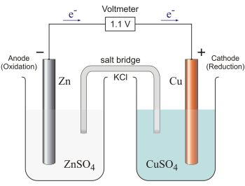
In the picture below, is the copper sulfate (CuSO₄) solution an electrolyte or a nonelectrolyte?

Slide 52
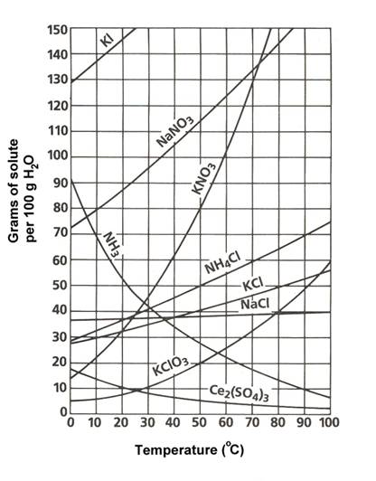
In the solubility graph shown, how many grams are needed to create a saturated solution of NaNO₃ at 10ºC?

Slide 53
Which of the following would increase the rate of dissolution of a solid in a liquid?
  Increase the temperature and increase the pressure
  Increase the temperature, stir the mixture, and increase the surface area
  Decrease the temperature and increase the pressure
  Decrease the temperature, stir the mixture, and increase the surface area

Slide 54
Which of the following compounds is likely to dissolve in water?
  NaCl
  OCl₂
  C₃H₈
  N₂

Slide 55
Which of the following best explains why sodium phosphate (Na₃PO₄) is soluble?
  It is an ionic compound
  All phosphates are soluble
  Phosphates are generally insoluble, except for those containing an alkali metal
  None of the above

Slide 56
A solution of 3.05 L contains 200.6g Mg(OH)₂. What is the molarity of the solution?

Slide 57
A chemist has a container of concentrated 17.0 M HCl. If she wants to prepare 1.75 L of 5.4 M HCl, how much of the concentrated solution will she need to use?

Slide 58
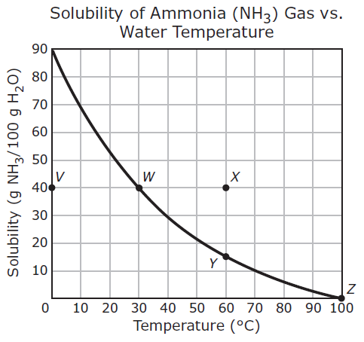
In the solubility graph shown, what type of solution is represented by Point X?

Slide 59
A student prepares a saturated solution of KCl in 100g H₂O at 80ºC. She then rapidly cools the solution to 50ºC. How much solute is likely to precipitate?

Slide 60
A 3.5g sample of whole sugar cubes dissolves very slowly in 100mL of water while the water is being stirred. Which of the following would likely cause the sugar cubes to dissolve faster?
  Decrease the water temperature
  Stop stirring
  Crush the sugar cubes
  Lower the air pressure

Slide 61
Which of the following compounds best explains why NH₂ dissolves in water?
  Water and NH₂ both have 3 atoms
  Water and NH₂ are both polar
  NH has a shape that dissolves
  NH₂ is a small molecule

Slide 62
For the following reaction, which products, if any, would form a precipitate in water?
Mg(NO₃)₂ + K₂CO₃ → MgCO₃ + 2 KNO₃
  MgCO₃
  KNO₃
  MgCO₃ and KNO₃
  No precipitates would form

Slide 63
Which of the following solutions has the highest concentration of solute?
  1.5 mol solute in 0.300L solvent
  3.1 mol solute in 0.600L solvent
  5.0 mol solute in 5.0L solvent
  2.5 mol solute in 1.5L solvent

Slide 64
If a solution is diluted by quadrupling (4x) its volume with water, what will happen to the concentration?
  It will increase by a factor of 10
  It will quadruple
  It will decrease by a half
  It will decrease by a factor of 10

Slide 65
Which of the following substances is a strong electrolyte when dissolved in water?
  C₃H₈
  NH₃
  K₃PO₄
  C₁₂H₂₂O₁₁

Slide 66
If 32g of KClO₃ are dissolved in 100g H₂O at 90ºC, what type of solution was made?

Slide 67
A 3.5g sample of whole sugar cubes dissolves very slowly in 100mL of water while the water is being stirred. Which of the following would likely cause the sugar cubes to dissolve faster?
  Decrease the water temperature
  Stop stirring
  Crush the sugar cubes
  Lower the air pressure

Slide 68
Closing
Good Luck
Studying

Slide 69
Warm Up: 3 Minutes
Write the Learning Target
Stay in your own seat
You should be working SILENTLY
Write three things that you could do once you get your test to ensure that you’re successful.
When you’re done, look through your notes and worksheets to prepare for the assessment.
No more than 4 people per row

Slide 70
Agenda
Warm Up: 5 Minutes
Goals/ Expectations for Assessment: 3 Minutes
Assessment: 42 Minutes
Closing: 3 Minutes

Slide 71
Why Prepare?
What is Mastery?
85%
26
Questions

Slide 72
Expectations for Assessment
Clear your desk of everything except a....
Number 2 Pencil
Scantron
Calculator
Backpacks and binders on the floor

Slide 73
Testing Tips
Read the problem and answer choices CAREFULLY
If you don’t know the answer, make sure you at least take a guess
Guessing on questions you don’t know can only help you!
Bubble your answers completely (scantron and test booklet)
Periodic Table is in the test packet

Slide 74
Testing Rules
Students will remain SILENT for the duration of the test. Even if you are done, YOU CANNOT TALK or MAKE OTHER NOISES
Keep your eyes on YOUR OWN PAPER
Raise your hand if you have a question
Failure to follow the testing rules will result in your test being taken. You will then receive a ZERO and a dean referral.

Slide 75
Good Luck!

Slide 76
Exam Correction
The question for #26 should read:
Which of the following procedures would increase the rate of dissolution of a SOLID in a liquid?
1 and 2
2 and 3
1, 3, and 4
1, 2, and 3

Slide 77
Closing
How was your assessment?
What could you have done differently?

Slide 78
Warm Up: 5 Minutes
Write the Learning Target
Stay in your own seat
You should be working SILENTLY
Backpacks and Computers under desk or on floor
Below is a table of different household items. They are categorized as either an acid or a base.
Based on this information, what do you think a property of an acid is? What about a base?
Acid | Base
Orange Juice | Soap
Lemon | Bleach
Vinegar | Baking soda
Coffee | Drain cleaner

Slide 79
Agenda
Warm Up [7 minutes]
Acids/Bases Notes [13 minutes]
Mini Lab [15 minutes]
Independent Practice [7 minutes]
Closing [3 Minutes]

Slide 80
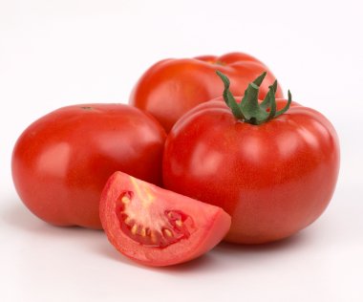
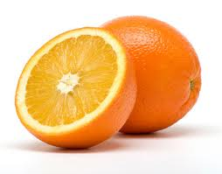
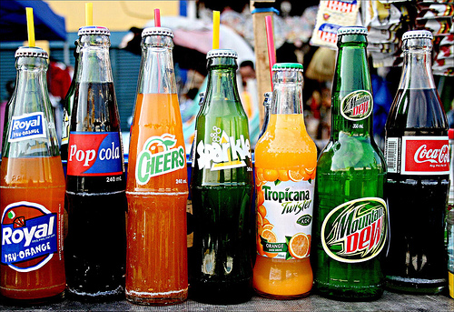
Acids

Slide 81
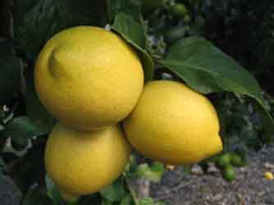
Acids
Produce H⁺ ions in solution
Tart or Sour Taste
Reacts with nonmetals
Corrosive
Examples: Grapefruit, Vinegar, Lemons

Slide 82
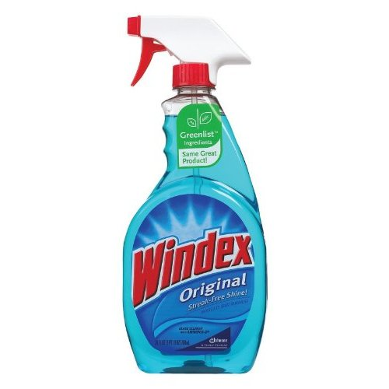
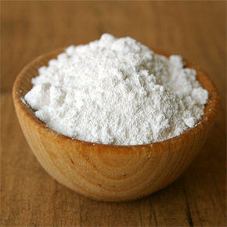
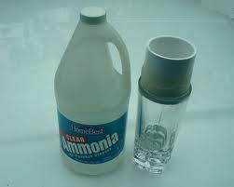
Base

Slide 83
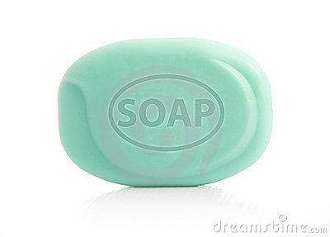
Base
Produce OH⁻ ions in a solution
Bitter taste
Soapy feel
Reacts with metal
Examples: Antacid Tablets, Household Cleaning Agents

Slide 84
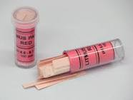
How to Distinguish Between Bases and Acids?
Litmus Paper

Slide 85
Acids:
Bases:
Turn Litmus Paper Red
Turn Litmus Paper Blue

Slide 86
Check Point
I produce OH⁻ ions. Who am I?
I am a Base

Slide 87
Check Point
I taste sour and produce H⁺ ions. Who am I?
I am an Acid

Slide 88
Check Point
I am corrosive and react with nonmetals. Who am I?
I am an Acid

Slide 89
Check Point
I taste bitter and react with metals. Who am I?
I am a Base

Slide 90
Mini Lab: Introduction to Acids and Bases
Purpose: To explore some of the physical properties of Acids and Bases
Predict which substances will be acidic or basic (3 minutes)
Student Role
Place a drop of the specific substance on Litmus Paper, record color of Litmus Paper
Determine whether or not the substance is Acidic or Basic based on our discussion.

Slide 91
How Will This Work?
There are six solutions on your lab bench (three on each side).
You will have four minutes on each side of the lab bench to test the solutions.
Mr. Ghosh will tell you when to switch.

Slide 92
Colors of Solutions:
Vinegar: Clear
Windex: Light Blue
Shampoo: Yellow
Orange Juice: Orange
Bleach: Light Yellow
Lime Juice: Bright Yellow

Slide 93
Answer Key
Substance | Before Color of Litmus Paper | After Color of Litmus Paper | Acid or Base?
Vinegar
Windex
Shampoo
Orange Juice
Bleach
Lime Juice

Slide 94
Answer Key
Substance | Before Color of Litmus Paper | After Color of Litmus Paper | Acid or Base?
Vinegar |  | Red
Windex
Shampoo
Orange Juice
Bleach
Lime Juice

Slide 95
Answer Key
Substance | Before Color of Litmus Paper | After Color of Litmus Paper | Acid or Base?
Vinegar |  | Red | Acid
Windex
Shampoo
Orange Juice
Bleach
Lime Juice

Slide 96
Answer Key
Substance | Before Color of Litmus Paper | After Color of Litmus Paper | Acid or Base?
Vinegar |  | Red | Acid
Windex |  | Blue
Shampoo
Orange Juice
Bleach
Lime Juice

Slide 97
Answer Key
Substance | Before Color of Litmus Paper | After Color of Litmus Paper | Acid or Base?
Vinegar |  | Red | Acid
Windex |  | Blue | Base
Shampoo
Orange Juice
Bleach
Lime Juice

Slide 98
Answer Key
Substance | Before Color of Litmus Paper | After Color of Litmus Paper | Acid or Base?
Vinegar |  | Red | Acid
Windex |  | Blue | Base
Shampoo |  | Blue
Orange Juice
Bleach
Lime Juice

Slide 99
Answer Key
Substance | Before Color of Litmus Paper | After Color of Litmus Paper | Acid or Base?
Vinegar |  | Red | Acid
Windex |  | Blue | Base
Shampoo |  | Blue | Base
Orange Juice
Bleach
Lime Juice

Slide 100
Answer Key
Substance | Before Color of Litmus Paper | After Color of Litmus Paper | Acid or Base?
Vinegar |  | Red | Acid
Windex |  | Blue | Base
Shampoo |  | Blue | Base
Orange Juice |  | Red
Bleach
Lime Juice

Slide 101
Answer Key
Substance | Before Color of Litmus Paper | After Color of Litmus Paper | Acid or Base?
Vinegar |  | Red | Acid
Windex |  | Blue | Base
Shampoo |  | Blue | Base
Orange Juice |  | Red | Acid
Bleach
Lime Juice

Slide 102
Answer Key
Substance | Before Color of Litmus Paper | After Color of Litmus Paper | Acid or Base?
Vinegar |  | Red | Acid
Windex |  | Blue | Base
Shampoo |  | Blue | Base
Orange Juice |  | Red | Acid
Bleach |  | Blue
Lime Juice

Slide 103
Answer Key
Substance | Before Color of Litmus Paper | After Color of Litmus Paper | Acid or Base?
Vinegar |  | Red | Acid
Windex |  | Blue | Base
Shampoo |  | Blue | Base
Orange Juice |  | Red | Acid
Bleach |  | Blue | Base
Lime Juice

Slide 104
Answer Key
Substance | Before Color of Litmus Paper | After Color of Litmus Paper | Acid or Base?
Vinegar |  | Red | Acid
Windex |  | Blue | Base
Shampoo |  | Blue | Base
Orange Juice |  | Red | Acid
Bleach |  | Blue | Base
Lime Juice |  | Red

Slide 105
Answer Key
Substance | Before Color of Litmus Paper | After Color of Litmus Paper | Acid or Base?
Vinegar |  | Red | Acid
Windex |  | Blue | Base
Shampoo |  | Blue | Base
Orange Juice |  | Red | Acid
Bleach |  | Blue | Base
Lime Juice |  | Red | Acid

Slide 106
Independent Practice
Take some time to practice applying your knowledge of acids and bases
85%
Practice makes Perfect

Slide 107
Closing
What are properties of an acid?
What are properties of a base?
What color does litmus paper turn in an acid?
What color does litmus paper turn in a base?

