Slide 1
Week 28 Chemistry
Dilutions, Types of Solutions, Solubility Curves

Slide 2
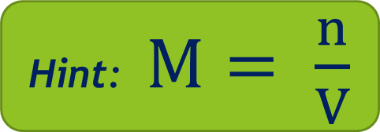
Warm Up: 4 Minutes
Write the Learning Target
Stay in your own seat
You should be working SILENTLY
How many moles of HCl are in 4.5L of 1.36M HCl?
Hint: $M= \frac{n}{V}$

Slide 3
Agenda
Warm Up [7 minutes]
Dilutions Video [18 minutes]
Guided Practice [12 minutes]
Independent Practice [13 minutes]
Closing [3 Minutes]

Slide 4
Dilutions Video
Go to shschem.weebly.com (our class website)
  Bookmark this if you haven’t done so already!!!
Hover over my page:
  Mr. Ghosh → Video Lessons
Watch video for March 24
Take notes on your handout

Slide 5
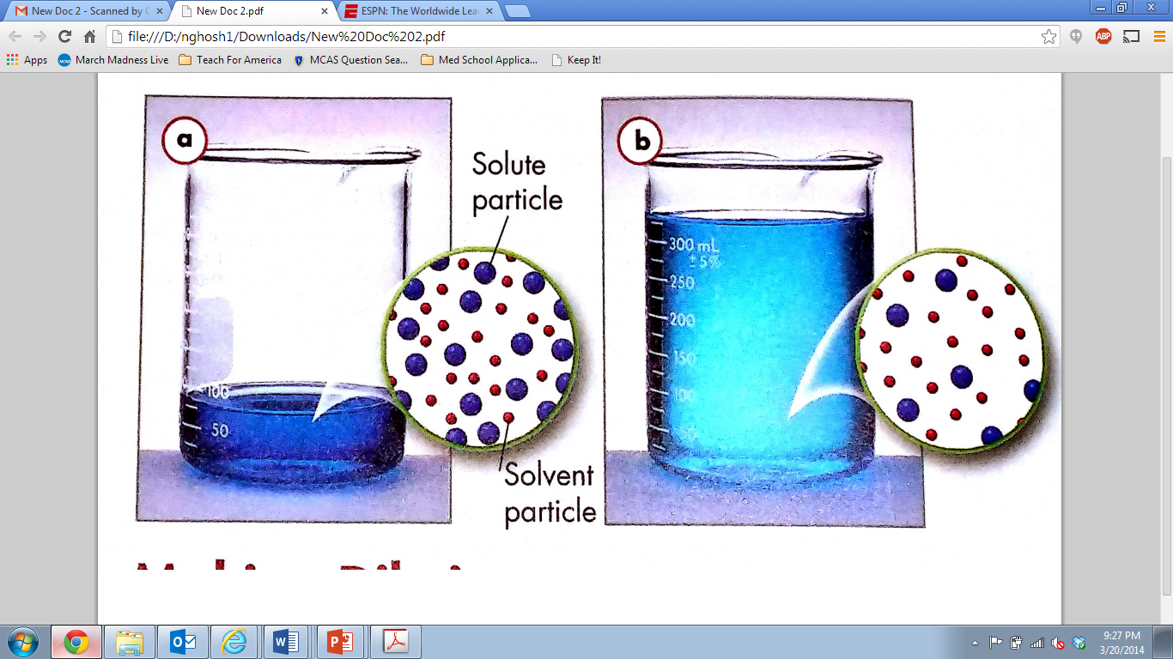
Which one has more solute?

Slide 6
Each of these solutions contains the same amount of solute.
How can this be?

Slide 7
Dilutions
Beaker A is more concentrated than Beaker B
  Beaker A has a higher Molarity than Beaker B
We had to dilute Beaker A to get Beaker B
Dilution:
Reducing the number of moles of solute per unit volume

Slide 8


What does this mean?
Moles of solute before dilution = Moles of solute after dilution
$$M= \frac{n}{V}$$
$$n=MV$$

Slide 9
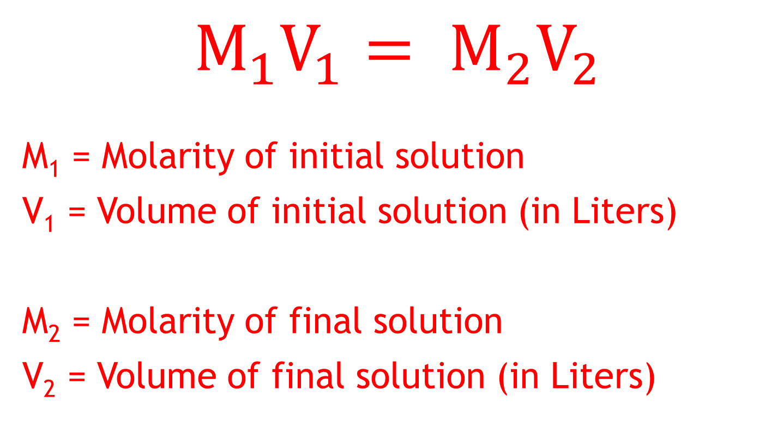
The Dilution Formula
Moles of solute before dilution = Moles of solute after dilution
$$M_{1}V_{1}= M_{2}V_{2}$$
M₁ = Molarity of initial solution
V₁ = Volume of initial solution (in Liters)
M₂ = Molarity of final solution
V₂ = Volume of final solution (in Liters)

Slide 10
Example 1
A chemistry student dilutes 1.46L of 5.0M sodium chloride to prepare 8.7L solution. What is the concentration of the new diluted solution?
G U E S S

Slide 11
Example 2
A chemist has a container of concentrated 15.0M sulfuric acid solution. If he wants to prepare 1.85L of 1.50M sulfuric acid, how much of the concentrated solution will he need to use?
G U E S S

Slide 12
Example 3
How much water must be added in order to dilute 0.50L of 14.5M HCl to a concentration of 6.0 M?
G U E S S

Slide 13
Guided Practice
Teacher:
  1. Will show the problem on the board
Students:
  Take 19 seconds to read the problem individually and write down the givens and unknown
  Take 41 seconds to solve the problem with your shoulder partner
  Be ready to share when Mr. Ghosh says SWAG

Slide 14
Guided Practice #1
A chemistry student dilutes 0.95L of 11.1M calcium hydroxide to prepare 2.88L solution. What is the concentration of the new diluted solution?
3.7 M

Slide 15
Guided Practice #2
A chemist has a container of concentrated 12.0M phosphoric acid. If he wants to prepare 0.76L of 1.00M phosphoric acid, how much of the concentrated solution will he need to use?
0.063 L

Slide 16
Guided Practice #3
How much water must be added in order to dilute 1.25L of 18.0M HNO₃ to a concentration of 4.50 M?
3.75 L

Slide 17
Independent Practice
Take some time to practice applying your knowledge of dilutions
85%
Practice makes Perfect

Slide 18
Closing
What formula do we use to calculate a dilution?
How do we know we are going to calculate a dilution?

Slide 19
Warm Up: 4 Minutes
Write the Learning Target
Stay in your own seat
You should be working SILENTLY
How much water does Beatriz need to add in order to dilute 0.750 L of 3.9 M NaCl solution to a concentration of 0.65 M?

Slide 20
Agenda
Warm Up [7 minutes]
Types of Solutions Video [15 minutes]
Guided Practice [12 minutes]
Independent Practice [15 minutes]
Closing [4 Minutes]

Slide 21
Types of Solutions Video
Go to shschem.weebly.com (our class website)
  Bookmark this if you haven’t done so already!!!
Hover over my page:
  Mr. Ghosh → Video Lessons
Watch video for March 25
Take notes on your handout

Slide 22
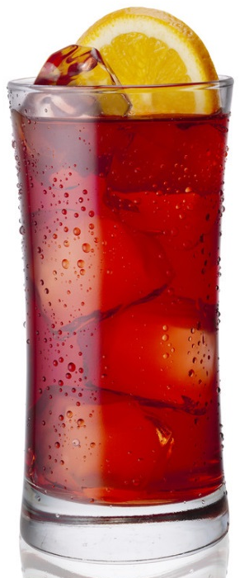
Let’s think about iced tea…

Slide 23
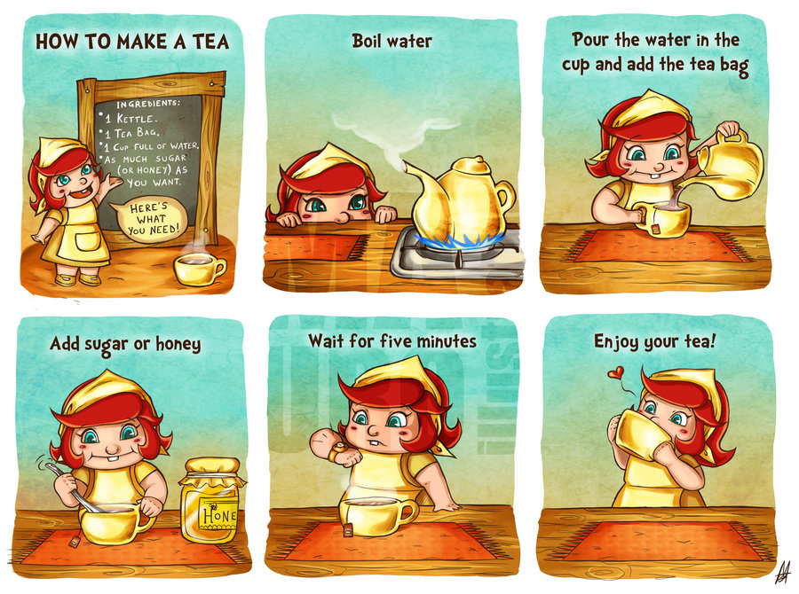
How do we make iced tea?

Slide 24
Hmm…Vocabulary?
We start by adding sugar, a little at a time:
  Unsaturated:
Once no more sugar can be dissolved:
  Saturated:
We heat the tea up to finish dissolving the sugar. Once it cools back down:
  Supersaturated:
More solute can be dissolved at the given temperature
No more solute can be dissolved at the given temperature
More solute is dissolved than usually possible at the given temperature

Slide 25
Check Point
Roberto is making 100mL iced tea. If the solubility of sugar is 30g/100mL at 25ºC:
  What type of solution is made when 10g of sugar are dissolved?
  What type of solution is made when 30g of sugar are dissolved?
  What type of solution is made when 50g of sugar are dissolved?

Slide 26
Let’s look at Iced Tea
Solubility = 30g/100mL
10g:
30g:
50g:
Unsaturated
Saturated
Supersaturated

Slide 27
Switching gears to…
Electrolytes

Slide 28
Electrolytes
Aqueous Solutions of Ionic Compounds
These conduct electricity
Examples: NaCl, BaSO₄, CuBr₃ Zn₃(PO₄)₂

Slide 29
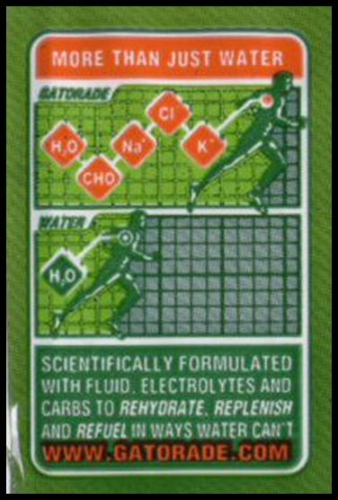

What’s another example?

Slide 30
Nonelectrolytes
Aqueous Solutions of Covalent Compounds
These do NOT conduct electricity
Examples: C₆H₁₂O₁₁, OCl₂, CH₄

Slide 31
Check Point
Is KCl an electrolyte?
  YES

Slide 32
Check Point
Is CO₂ an electrolyte?
  NO

Slide 33
Guided Practice
Teacher:
  1. Will show the problem on the board
Students:
  Take 19 seconds to read the problem individually
  Take 41 seconds to solve the problem with your shoulder partner
  Be ready to share when Mr. Ghosh says SWAG

Slide 34
Guided Practice #1
Jose was making 1L of his own Gatorade at home. He decided that he needed 7 teaspoons of the Gatorade powder, or a total of 140g of powder. However, he forgot that the solubility of Gatorade was only 105g/L. What type of solution did Jose make?
Supersaturated

Slide 35
Guided Practice #2
Arely is attending a party on Friday night. She has been asked to bring some iced tea. Even though the party only required 0.750L, she decided to make 1L so she could save a little for herself. The solubility of sugar in iced tea is 205g/L. The recipe on the food network said to use 190g/L, but Arely decided to make her tea a little less sweet. She ended up using only 140g of sugar in her 1L of iced tea. What type of solution did she make?
Unsaturated

Slide 36
Guided Practice #3
Tonight, Willie is going to make 1L of grape Kool-aid to share with the class on Wednesday. Reading the directions on the packet, he finds that the solubility of the powder in water is 100g/L. Since Willie always follows directions, he put exactly 100g of the powder in his 1L of solution. What type of solution did he make?
Saturated

Slide 37
Guided Practice #4
Laurynce was looking for a new sports drink to take him to the next level in basketball. After talking to Mark, he learned about a new sports drink called BodyArmor. BodyArmor claims to be better than Gatorade because it contains more energy, along with 600mg of Potassium. Based on this, would you classify BodyArmor as an electrolyte? Why or why not?
Yes, Potassium is a metal, so the solution is an electrolyte

Slide 38
Guided Practice #5
While drinking Coca Cola, Alondra was reading the label. She found that the two main ingredients in Coca Cola were carbonic acid (H₂CO₃) and fructose (C₆H₁₂O₆). Based on this, would you classify Coca Cola as an electrolyte? Why or why not?
No, carbonic acid and fructose are covalent compounds. Solutions of covalent compounds are nonelectrolytes

Slide 39
Independent Practice
Take some time to practice applying your knowledge of types of solutions
85%
Practice makes Perfect

Slide 40
Closing
How do we know if something is a saturated solution?
What types of compounds form electrolytes in aqueous solution?

Slide 41
Warm Up: 4 Minutes
Write the Learning Target
Stay in your own seat
You should be working SILENTLY
The solubility of sugar in tea is 70g/100mL. If you are making 100mL of tea and add 100g of sugar (which all dissolves), what type of solution have you made? How do you know?
Sugar has a formula of C₁₂H₂₂O₁₁. Based on this, would you classify sugar as an electrolyte? Why or why not?

Slide 42
Warm Up: 9 Minutes
Write the Learning Target
Stay in your own seat
  Review

Slide 43
Warm Up: 9 Minutes
Write the Learning Target
Stay in your own seat
You should be working SILENTLY
  Review Quiz
Use your Notes!!
  Log into your computer
  Go to m.socrative.com
  Enter room number: 230538
  Finish all questions

Slide 44
Agenda
Warm Up [9 minutes]
Solubility Curves Video [15 minutes]
Guided Practice [12 minutes]
Independent Practice [15 minutes]
Closing [2 Minutes]

Slide 45
Solubility Curves Video
Go to shschem.weebly.com (our class website)
  Bookmark this if you haven’t do so already!!!
Hover over my page:
  Mr. Ghosh → Video Lessons
Watch video for March 26
Take notes on your handout

Slide 46
Let’s review the types of solutions
Unsaturated:
Saturated:
Supersaturated:
More solute can be dissolved at the given temperature
No more solute can be dissolved at the given temperature
More solute is dissolved than usually possible at the given temperature

Slide 47
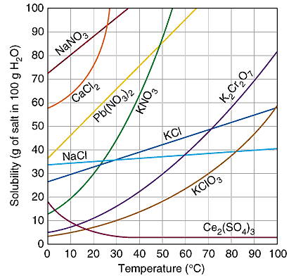
Solubility Curves!
But how do we use this?

Slide 48
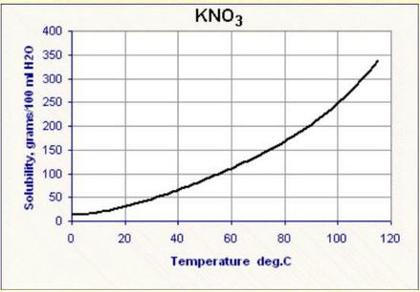
Solubility Curves
Show the solubility of a compound over a range of temperatures
Supersaturated
Saturated
Unsaturated

Slide 49
Example 1
If 300g of KNO₃ are dissolved in 100g H₂O at 60ºC, what type of solution was made?

Slide 50
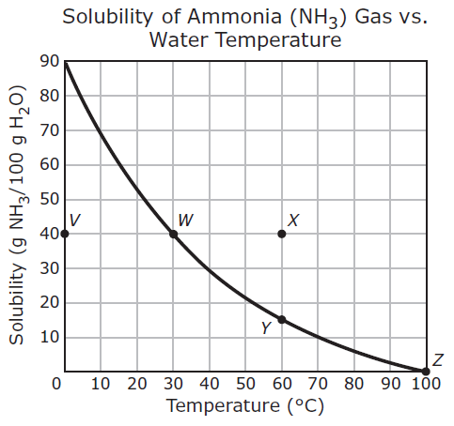
Example 2
The solubility curve of ammonia is shown to the right:
Between which two points did the solution change from being supersaturated to saturated?

Slide 51
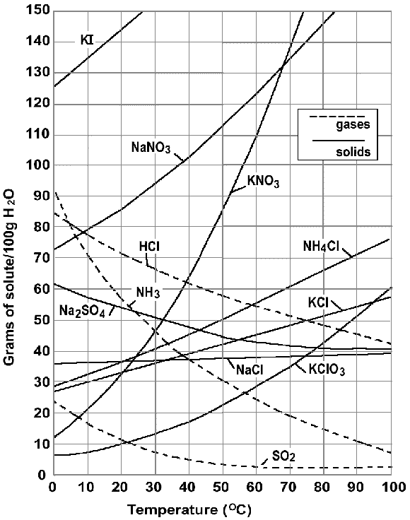
Example 3
If a saturated solution of NaNO₃ is made at 50ºC and then rapidly cooled to 20ºC, how much solute is likely to precipitate?

Slide 52
Guided Practice
Teacher:
  1. Will show the problem on the board
Students:
  Take 19 seconds to read the problem individually and write down the givens and unknown
  Take 41 seconds to solve the problem with your shoulder partner
  Be ready to share when Mr. Ghosh says SWAG

Slide 53
Guided Practice #1
If 200g of KNO₃ are dissolved in 100g H₂O at 90ºC, what type of solution was made?
Saturated

Slide 54
Guided Practice #2
The solubility curve of ammonia is shown to the right:
Between which two points did the solution remain saturated?
W → Y

Slide 55
Guided Practice #3
If a saturated solution of KCl is made at 85ºC and then rapidly cooled to 60ºC, how much solute is likely to precipitate?
~8g KCl

Slide 56
Independent Practice
Take some time to practice applying your knowledge of types of solubility curves
85%
Practice makes Perfect

Slide 57
Closing
What type of solution do all points below the solubility curve represent?
How do we know how many grams of a solute must be dissolved to create a saturated solution at a given temperature?

Slide 58
Warm Up: 4 Minutes
Stay in your own seat
Write the Learning Target
You should be working SILENTLY
How many grams of KNO₃ are required to make a saturated solution at 20ºC?
If a saturated solution of K₂Cr₂O₇ is made at 90 ºC and rapidly cooled to 50 ºC, how much solute is likely to precipitate?

Slide 59
Announcements
Quiz Tomorrow
Topics Include:
  Solubility Rules
  Molarity
  Dilutions
  Types of Solutions
  Solubility Curves

Slide 60
Agenda
Warm Up: 7 Minutes
Expectations for Stations: 6 minutes
Stations Review: 38 minutes
Closing: 2 Minutes

Slide 61
How Will Stations Work??
You will be placed with a group of other scholars to complete four stations on the following topics:
Station 1: Solubility Rules
Station 2: Molarity Calculations
Station 3: Dilutions
Station 4: Types of Solutions
You Need:
Periodic Table
Scratch Paper

Slide 62
How Will Stations Work??
You will spend 9 minutes at each station working each problem as a group on scratch paper.
You will write your FINAL answer on the answer document.
When time is called, you will leave your current station and move on to the next station
You will have 10 seconds to move to the next station

Slide 63
Closing
Why did we review these concepts?
Why is it important that everybody master these objectives?
Good Luck on Your Quiz

Slide 64
Warm Up: 3 Minutes
Write the Learning Target
Stay in your own seat
You should be working SILENTLY
A solubility curve is shown to the right:
What type of solution would be produced at:
  Point V?
  Point W?
  Point X?
  Point Y?
  Point Z?

Slide 65
Agenda
Warm Up [5 minutes]
Expectations for Quiz [4 minutes]
Quiz [35 minutes]
Closing [1 Minutes]

Slide 66
Goal
To demonstrate mastery, we are shooting for
85%

Slide 67
Check Point
What is your goal for this quiz?
85%

Slide 68
Expectations for Quiz
Clear your desk of everything except a....
Pencil
Calculator
All backpacks and binders on the floor

Slide 69
Expectations
Students will keep eyes on own paper
  Cheating will result in an automatic ZERO
Students will remain SILENT for the duration of the quiz

Slide 70
Good Luck!!

Slide 71
Closing
How was your Quiz Today?
What topics do you feel you still need review on?

