Slide 1
Week 27 Chemistry
Unit 7 Assessment, Solutions

Slide 2
Warm Up: 3 Minutes
Write the Learning Target
Stay in your own seat
You should be working SILENTLY
Write three things that you could do once you get your test to ensure that you’re successful.
When you’re done, look through your notes and worksheets to prepare for the assessment.
No more than 4 people per row

Slide 3
Agenda
Warm up: 5 minutes
Goals/ Expectations for Assessment: 3 Minutes
Assessment: 42 Minutes
Closing: 3 Minutes

Slide 4
Why Prepare?
What is Mastery?
85%
10
Questions

Slide 5
Expectations for Assessment
Clear your desk of everything except a....
Number 2 Pencil
Scantron
Calculator
Backpacks and binders on the floor

Slide 6
Testing Tips
Read the problem and answer choices CAREFULLY
Make sure you show work for all problems
  Questions without work will automatically be marked INCORRECT
Bubble your answers completely (scantron and test booklet)
Periodic Table is in the test packet

Slide 7
Testing Rules
Students will remain SILENT for the duration of the test. Even if you are done, YOU CANNOT TALK or MAKE OTHER NOISES
Keep your eyes on YOUR OWN PAPER
Raise your hand if you have a question
Failure to follow the testing rules will result in your test being taken. You will then receive a ZERO and a dean referral.

Slide 8
Good Luck!

Slide 9
Closing
How was your Exam Today?
What topics do you feel you still need review on?

Slide 10
Warm Up: 4 Minutes
Write the Learning Target
Stay in your own seat
You should be working SILENTLY
Why is water important in our lives? Write at least three sentences.

Slide 11
Agenda
Warm Up [7 minutes]
Water Video [14 minutes]
Guided Practice [12 minutes]
Independent Practice [17 minutes]
Closing [3 Minutes]

Slide 12
Water Video
Go to shschem.weebly.com (our class website)
  Bookmark this if you haven’t do so already!!!
Hover over my page:
  Mr. Ghosh → Video Lessons
Watch video for March 11
Take notes on your handout

Slide 13
Compounds

Slide 14
Compounds
Ionic

Slide 15
Compounds
Covalent
Ionic

Slide 16
Compounds
Covalent
Polar
Ionic

Slide 17
Compounds
Covalent
Polar
Ionic
Nonpolar

Slide 18
Polar Covalent Compounds
Molecules have a positive end (H) and a negative end (F, O, or N)
Examples: H₂O, R-OH (Alcohols), NH_{3,} HF

Slide 19
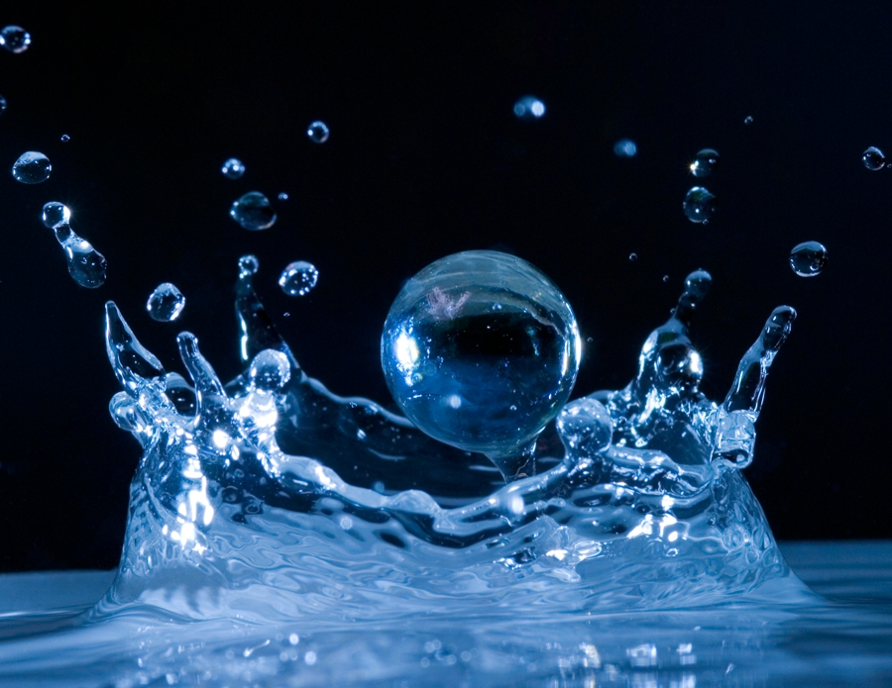
What is H₂O???
Water!

Slide 20
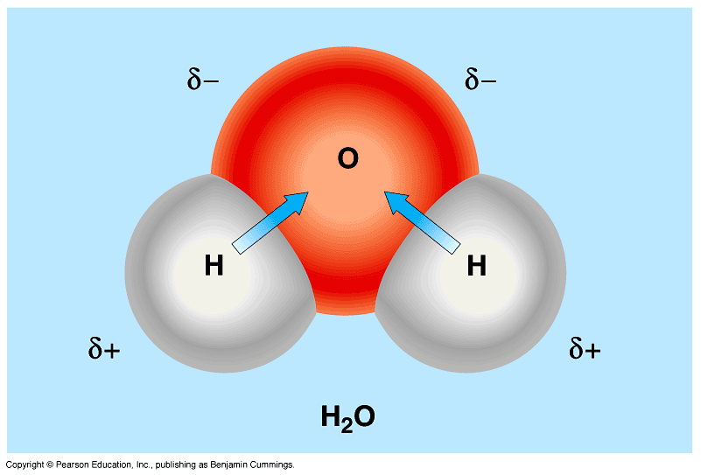
Polar Covalent Molecule: Water
In a water molecule, oxygen is the negative end and hydrogen is the positive end
Covalent = Shared
Oxygen pulls the shared electrons toward itself;
partial negative
the electrons spend more time near the oxygen atom.
partial positive
partial positive

Slide 21
But wait…
What happens if the positive end of a water molecule meets the negative end of another water molecule?

Slide 22
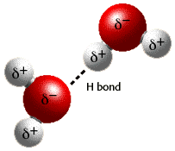
Hydrogen Bonding
Hydrogen in a polar covalent molecule bonds to the negative end (F, O, N) of another polar covalent molecule

Slide 23
What does mean for us?
Like dissolves like!
Water’s polarity helps it dissolve other charged compounds
  Polar Covalent Compounds
  Ionic Compounds
Aqueous Solution: Water with dissolved substances

Slide 24
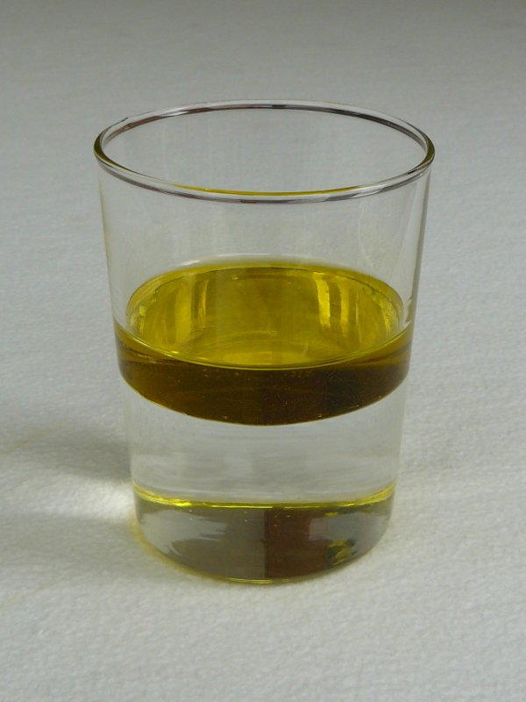
Nonpolar Covalent Compounds
Do not have a positive end and a negative end.
Examples: N_{2,} CH₄, Oil
Water does NOT dissolve nonpolar molecules.

Slide 25
Check Point
Would O₂ dissolve in water?
NO

Slide 26
Check Point
Would NH₃ dissolve in water?
YES

Slide 27
Guided Practice
Teacher:
  1. Will show the problem on the board
Students:
  Take 17 seconds to read the problem individually
  Take 48 seconds to solve the problem with your shoulder partner
  Be ready to share when Mr. Ghosh says SWAG

Slide 28
Guided Practice #1
Draw the structure of water below[include charges]:

Slide 29
Guided Practice #2
Which characteristic of a molecule most impacts whether it will dissolve in water?
  a. Size
  b. Polarity
  c. Ionization energy
  d. Shape
B

Slide 30
Guided Practice #3
Which types of compounds dissolve in water?
Why do they dissolve in water?
Polar covalent and ionic compounds dissolve in water because the partial positive end of water attracts the partial negative end of the compound (and vice versa).

Slide 31
Guided Practice #4
Circle the compounds that will dissolve in water:
O₂ C₂H₆ NH₃ KCl

Slide 32
Guided Practice #5
Circle the compounds that will dissolve in water:
Ca(OH)₂ N₂ CH₃OH Oil

Slide 33
Independent Practice
Take some time to practice applying your knowledge of water
85%
Practice makes Perfect

Slide 34
Independent Practice
Polarity
NaCl. Because it is an Ionic compound.
Rubbing alcohol. Alcohols are polar and they dissolve in water.
The water molecule has a polar structure. Polar structures dissolve ionic compounds and polar covalent compounds

Slide 35
Closing
Is water important? Why?
Why is water polar?

Slide 36
Wednesday at G/T Training…
Solubility Rules were covered

Slide 37
Warm Up: 4 Minutes
Write the Learning Target
Stay in your own seat
You should be working SILENTLY
Which of the following substances would dissolve in water? Why?
CH₄
C₂H₅OH
K₂SO₄
F₂

Slide 38
Agenda
Warm Up [7 minutes]
Solubility Rules Video [14 minutes]
Guided Practice [12 minutes]
Independent Practice [17 minutes]
Closing [3 Minutes]

Slide 39
Solubility Rules Video
Go to shschem.weebly.com (our class website)
  Bookmark this if you haven’t do so already!!!
Hover over my page:
  Mr. Ghosh → Video Lessons
Watch video for March 12
Take notes on the handout

Slide 40
Solubility Rules
Tell us whether the compound will dissolve in water
Soluble = dissolves
Insoluble = does not dissolve

Slide 41
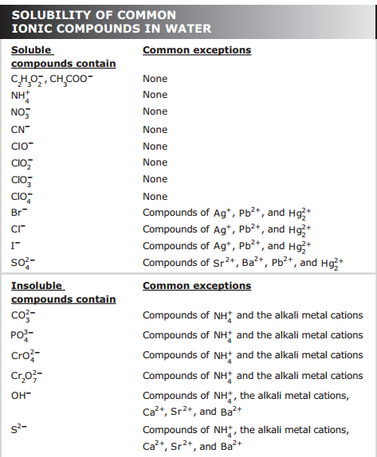
This is on the back of your Periodic Table…

Slide 42
Example 1
NaCl

Slide 43
Example 2
Silver (I) Carbonate

Slide 44
Example 3
Lead (II) Bromide

Slide 45
Example 4
K₃PO₄

Slide 46
Check Point
Is Sodium Carbonate soluble or insoluble?
Soluble

Slide 47
Check Point
Is AgCl soluble or insoluble?
Insoluble

Slide 48
Guided Practice
Teacher:
  1. Will show the problem on the board
Students:
  Take 16 seconds to read the problem individually
  Take 29 seconds to solve the problem with your shoulder partner
  Be ready to share when Mr. Ghosh says SWAG

Slide 49
Guided Practice #1
Is AgBr soluble or insoluble?
Insoluble

Slide 50
Guided Practice #2
Is potassium cyanide soluble or insoluble?
Soluble

Slide 51
Guided Practice #3
Is BaCO₃ soluble or insoluble?
Insoluble

Slide 52
Guided Practice #4
Is lithium dichromate soluble or insoluble?
Soluble

Slide 53
Independent Practice
Take some time to practice applying your knowledge of solubility rules
85%
Practice makes Perfect

Slide 54
Closing
How do we know if an ionic compound is soluble in water?
Is PbCl₂ soluble or insoluble?

Slide 55
Warm Up: 4 Minutes
Write the Learning Target
Stay in your own seat
You should be working SILENTLY
Classify each of the following compounds as soluble or insoluble
Silver (I) Chloride
KNO₃
Barium Phosphate
(NH₄)₂S

Slide 56
Agenda
Warm Up [7 minutes]
Review of Solubility Rules [5 minutes]
Molarity Video [12 minutes]
Guided Practice [12 minutes]
Independent Practice [14 minutes]
Closing [3 Minutes]

Slide 57
Let’s Review Solubility Rules!

Slide 58
Review #1
Zn(NO₃)₂

Slide 59
Review #2
Calcium Carbonate

Slide 60
Review #3
Strontium Sulfate

Slide 61
Review #4
KOH

Slide 62
Molarity Video
Go to shschem.weebly.com (our class website)
  Bookmark this if you haven’t do so already!!!
Hover over my page:
  Mr. Ghosh → Video Lessons
Watch video for March 13
Take notes on your handout

Slide 63
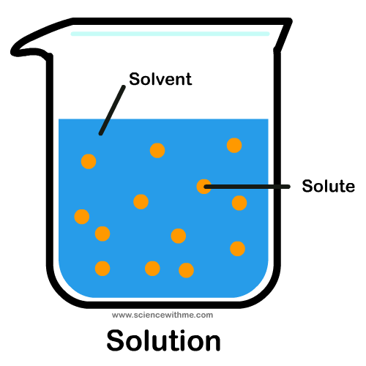
Key Vocabulary
Solution:
Solute:
Solvent:
Homogeneous mixture
Substance being dissolved
Substance doing the dissolving

Slide 64
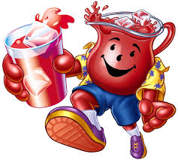
Let’s look at Kool-Aid
Solution:
Solvent:
Solute:
Finished Kool-Aid
Water
Kool-Aid Powder

Slide 65

Which glass is most concentrated?

Slide 66

How do we measure concentration?
Molarity (M):
Number of moles of solute per liter of solution
$$M= \frac{n}{L}$$
n = number of moles
L = Volume of solution (in Liters)

Slide 67
Example 1
6.2 moles BaCl₂ are dissolved in 2.11L water. What is the molarity of the solution?

Slide 68
Example 2
Warren had 3.1L of a 5.2 M CuSO₄ solution. How many moles of CuSO₄ were in the solution?

Slide 69
Example 3
If you have 3.44M glucose (C₆H₁₂O₆) solution, how many liters of the solution would contain 31 moles glucose?

Slide 70
Check Point
What formula do we use to calculate concentration?
$$M= \frac{n}{L}$$

Slide 71
Guided Practice
Teacher:
  1. Will show the problem on the board
Students:
  Take 19 seconds to read the problem individually and write down the givens and unknown
  Take 41 seconds to solve the problem with your shoulder partner
  Be ready to share when Mr. Ghosh says SWAG

Slide 72
Guided Practice #1
4.1 moles of lithium bromide are dissolved in 1.32L water. What is the molarity of the solution?
3.1 M

Slide 73
Guided Practice #2
Cequel had 0.75L of a 2.91 M NaCrO₄ solution. How many moles of NaCrO₄ were in the solution?
2.2 moles NaCrO₄

Slide 74
Guided Practice #3
If you have 1.81 M sodium hydroxide solution, how many liters of the solution would contain 11.7 moles sodium hydroxide?
6.46 Liters

Slide 75
Independent Practice
Take some time to practice applying your knowledge of molarity
85%
Practice makes Perfect

Slide 76
Closing
How do we calculate the concentration of a solution
What are the units of concentration?

Slide 77
Warm Up: 3 Minutes
Write the Learning Target
Stay in your own seat
You should be working SILENTLY
17.5 moles of KCl are dissolved in 0.94L of solution. What is the molarity of the solution?

Slide 78
Agenda
Warm Up [5 minutes]
Molarity Video-Part 2 [14 minutes]
Guided Practice [12 minutes]
Independent Practice [12 minutes]
Closing [2 Minutes]

Slide 79
Molarity Video-Part 2
Go to shschem.weebly.com (our class website)
  Bookmark this if you haven’t do so already!!!
Hover over my page:
  Mr. Ghosh → Video Lessons
Watch video for March 14
Take notes on your handout

Slide 80
Example 1
2.11L of solution contains 42g Na₂O. What is the molarity of the solution?

Slide 81

Uh oh…
Our molarity formula can only use number of moles, not grams.
Convert grams to moles!
$$M= \frac{n}{L}$$
$$Mass \left(in grams\right)=Moles × Molar Mass$$

Slide 82
Example 1
2.11L of solution contains 42g Na₂O. What is the molarity of the solution?

Slide 83
Example 2
How many grams of potassium carbonate (K₂CO₃) are dissolved in 1.56L of 2.11M solution?

Slide 84
Check Point
How do we convert from grams to moles?
$$Mass \left(in grams\right)=Moles × Molar Mass$$

Slide 85
Guided Practice
Teacher:
  1. Will show the problem on the board
Students:
  Take 17 seconds to read the problem individually and write down the givens and unknown
  Take 63 seconds to solve the problem with your shoulder partner
  Be ready to share when Mr. Ghosh says SWAG

Slide 86
Guided Practice #1
13.2L of solution contains 183g K₂Cr₂O_{7.} What is the molarity of the solution?
0.0471 M

Slide 87
Guided Practice #2
How many grams of silver (I) chlorate (AgClO₃) are dissolved in 0.630L of 15.1M solution?
1820g AgClO₃

Slide 88
Guided Practice #3
How many moles of aluminum phosphate (AlPO₄) are dissolved in 0.52L of 0.66M solution?
0.34 mol AlPO₄

Slide 89
Independent Practice
Take some time to practice applying your complete knowledge of molarity
85%
Practice makes Perfect

Slide 90
Closing
How do we calculate the concentration of a solution
What are the units of concentration?

Slide 91

Have Fun, Stay Safe!

