Slide 1
Week 23 Chemistry
LOCM, Balancing Equations, Review, Assessment 6

Slide 2
Warm Up: 4 Minutes
Please do not move the stools
Stay in your own seat
You should be working SILENTLY
  Log into your computer
  Go to m.socrative.com
  Enter room number: 230538
  Finish all questions
When you are finished, check your grades on PS Connect

Slide 3
Agenda
Warm Up [7 minutes]
Notes/Examples [15 minutes]
Guided Practice [12 minutes]
Independent Practice [15 minutes]
Closing [4 Minutes]

Slide 4
Does this Chemical Reaction Follow the Law of Conservation of Mass?
H₂ + O₂ → H₂O
…
NO! ☹

Slide 5
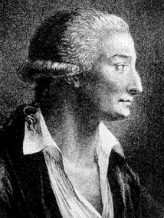
Chemical Reactions
Because of the Law of
conservation of mass,
an equation must be balanced.
It must have the same number of atoms of the same kind on both sides.
Lavoisier, 1788

Slide 6
Why is this reaction not balanced?
H₂ + O₂ → H₂O

Slide 7
To Balance Chemical Reactions...
_2_H₂ + ___ O₂ ---> _2_ H₂O
1. You must add or change coefficients in front of chemical formulas
2. You cannot add or change the subscript

Slide 8
To Balance Chemical Reactions...
Step 1: Determine the number of each atom on each side of the reaction..
__H₂ + __O₂ → __H₂O
H= H=
O= O=
Step 4: Continue adding coefficients to get the same number of atoms of each element on each side.
Step 2: Pick an element that is not equal on both sides of the chemical reaction.
Step 3: Add a coefficient in front of the formula with that element and adjust the count.

Slide 9
Example 2:
___Mg + ___ HF → ___ MgF₂ + ___ H₂
Mg = Mg=
H = H =
F = F=

Slide 10
Guided Practice
Teacher:
  1. Will show the problem on the board
Students:
  Take 22 seconds to identify the elements on each side and the number of each.
  Take 68 seconds to balance the equation with your shoulder partner
  Be ready to share when Mr. Ghosh says SWAG

Slide 11
Guided Practice #1
4
3
__Al + __S₂ → 2 Al₂S₃
Al = Al =
S = S =
What is the coefficient for Aluminum Sulfide?
2

Slide 12
Guided Practice #2
1
2
2
1
__Br₂ + __LiF → LiBr + F₂
Br = Br =
Li = Li =
F = F =

Slide 13
Guided Practice #3
1
1
1
2
__BaCl₂ + __H₂SO₄ → BaSO₄ + HCl
What is the coefficient for Barium Sulfate?
1

Slide 14
Independent Practice
Take some time to practice balancing the following equations
85%
Practice makes Perfect

Slide 15
When you are finished…
Go to the class website (shschem.weebly.com)
Check the new tab labeled “Quizzes and Tests”
  Open the Answer Key for the Quiz on Friday and look through how to do each problem

Slide 16
Answer Key for Balancing
1,2,1,1
4, 3, 2
2,1,2
1,3,2
2, 1,4,1

Slide 17
Closing
If a reaction is unbalanced, is it following the Law of Conservation of Mass?
How do we make the reaction balanced?

Slide 18
Warm Up: 4 Minutes
Sit in your assigned seat
You should be working SILENTLY
  Log into your computer
  Go to m.socrative.com
  Enter room number: 230538
  Finish all questions
When you are finished, check your grades on PS Connect

Slide 19
Reminder!!!
Exam Thursday

Slide 20
Agenda
Warm Up [7 minutes]
Notes/Examples [15 minutes]
Guided Practice [12 minutes]
Independent Practice [15 minutes]
Closing [4 Minutes]

Slide 21
Recap of How to Balance a Chemical Reaction?
List out the element on the reactant and product side
Count the number of atoms of each element
Pick an element that is not equal on both sides of the chemical reaction
Add a coefficient in front of the formula with that element and adjust the count
Continue adding coefficients to get the same number of atoms of each element on each side

Slide 22
Example 1
__H₂O₂ → __H₂O + __O₂

Slide 23
Example 2
___K₂O + ___H₂O → ___KOH

Slide 24
Example 3
_ Sr (C₂H₃O₂)₂ + _Rb₃PO₄ → _Sr₃(PO₄)₂ + _ RbC₂H₃O₂

Slide 25
Guided Practice
Teacher:
  1. Will show the problem on the board
Students:
  Take 22 seconds to identify the elements on each side and the number of each.
  Take 68 seconds to balance the equation with your shoulder partner
  Be ready to share when Mr. Ghosh says SWAG

Slide 26
Guided Practice 1
__NO + __O₂ → __NO₂
2,1,2

Slide 27
Guided Practice 2
__Mg(NO₃)₂ + __K₂SO₄ → __ KNO₃ + __ MgSO₄
1,1,2,1

Slide 28
Guided Practice 3
__C₂H₂ + __O₂ → __ CO₂ +__ H₂O
2,5,4,2

Slide 29
Guided Practice 4
Fill in the missing blank:
6 CO₂ + 6 H₂O → _________ + 6 O₂
C₄H₈O₆
C₆H₁₂O₆
C₆H₆O₆
C₆H₁₀O₁₂
C₆H₁₂O₆

Slide 30
Independent Practice
Take some time to practice balancing the following equations
85%
Practice makes Perfect

Slide 31
Closing
What approach should you follow to ensure you balance a chemical reaction correctly?

Slide 32
Warm Up: 4 Minutes
Stay in your own seat
You should be working SILENTLY
  Log into your computer
  Go to m.socrative.com
  Enter room number: 230538
  Finish all questions
When you are finished, check your grades on PS Connect

Slide 33
Agenda
Warm Up- 7 Minutes
Purpose of Review/ Material Covered- 3 Minutes
Expectations for White Board Jeopardy- 3 Minutes
White Board Jeopardy- 37 Minutes
Closing- 3 Minutes

Slide 34
Purpose of Reviewing
Prepare for Assessment 6

Slide 35
Why Prepare?
85%
17
Questions

Slide 36
Material Covered on Assessment 6
Mole Calculations (1 and 2 step)
Molar Mass
Percent Composition
Empirical Formulas
Molecular Formulas
Balancing Chemical Equations
Naming Compounds/Writing Formulas

Slide 37
White Board Jeopardy
Students will work in groups of 3 to 4 (Team number is on the desk in front of you).
Students will need Dry Erase Board, Marker, Periodic Table, and Eraser.
NOTES are allowed during White Board Jeopardy

Slide 38

White Board Jeopardy
Team #
How to Play???
Write your team number in the upper right hand corner
During the song, you will work the problem shown in your lap INDIVIDUALLY.
At the end of the Jeopardy song, you will talk with your group.
When Mr. Ghosh says “Boards Up” , all students in group must have Identical responses on their Dry Erase Boards that are correct in order to receive FULL CREDIT. Boards that are not up will not be counted.
You may be called on randomly to explain your answer. If I do this and you cannot explain correctly, your team will NOT receive credit.

Slide 39
Scoring and Rules/Expectations
Scoring:
All questions are worth 1 point
Rules/Expectations:
No talking during the Jeopardy song
Must be working individually during the song
No arguing with Mr. Ghosh about scoring
Must be explaining WHY during group work time
Any violations of the rules/expectations will result in your team losing a point

Slide 40
Prizes!
The team that finishes with the most number of points will receive 5% extra credit on the Exam tomorrow.

Slide 41

How many atoms are in 0.711 moles of Helium?

Slide 42
What is the molar mass of Barium Fluoride?

Slide 43
What is the percent composition by mass of the elements in AgNO₃?

Slide 44
What is the empirical formula for a compound that is 57.14% C, 6.16% H, 9.52% N, and 27.18% O?

Slide 45
What is the molecular formula for a compound with an empirical formula of C₄H₄O and a molar mass of 136 g/mol?

Slide 46
Balance the following equation:
___Na₃PO₄ + ___KOH → ___NaOH + ___K₃PO₄

Slide 47
What is the name for CdSO₄?

Slide 48
How many chlorate ions are in 3.62 moles of Calcium Chlorate?

Slide 49
How many molecules are in 4.60 moles of Sulfur Trioxide gas?

Slide 50
A 0.41g sample of a compound containing Carbon, Nitrogen, and Oxygen was burned. The sample contained 0.13g of Oxygen. What is the percentage of Oxygen in this compound?

Slide 51
What is the empirical formula for a compound that is 67.1% Zinc and 32.9% Oxygen?

Slide 52
What is the molecular formula for a compound with an empirical formula of C₂OH₄ and a molar mass of 88 g/mol?

Slide 53
What is the coefficient for Cesium when the following equation is balanced?
__GaF₃ + ___Cs → ___CsF + ___Ga

Slide 54
What is the chemical formula for Carbonic Acid?

Slide 55
How many moles are in 5.91 x 10²⁷ atoms of Xenon?

Slide 56
How many moles are in 6.19 x 10³⁴ molecules of Diphosphorus Nonanitride?

Slide 57
What is the percent composition by mass of the elements in Aluminum Nitrate?

Slide 58
What is the empirical formula for a compound that is 44.82% Potassium, 18.39% Sulfur, and 36.79% Oxygen?

Slide 59
What is the molecular formula for a compound with an empirical formula of C₂H₈N and a molar mass of 46 g/mol?

Slide 60
What is the coefficient for Calcium Carbonate when the following equation is balanced?
__Ca(OH)₂ + ___CO₂ → ___CaCO₃ + ___H₂O

Slide 61
What is the molar mass of Lithium Perchlorate?

Slide 62
Closing
Good Luck
Studying

Slide 63
Warm Up: 3 Minutes
Write the Learning Target
Stay in your own seat
You should be working SILENTLY
Write three things that you could do once you get your test to ensure that you’re successful.
When you’re done, look through your notes and worksheets to prepare for the assessment.
No more than 4 people per row

Slide 64
Agenda
Warm Up: 5 Minutes
Goals/ Expectations for Assessment: 3 Minutes
Assessment: 42 Minutes
Closing: 3 Minutes

Slide 65
Why Prepare?
What is Mastery?
85%
17
Questions

Slide 66
Expectations for Assessment
Clear your desk of everything except a....
Number 2 Pencil
Scantron
Calculator
Backpacks and binders on the floor

Slide 67
Testing Tips
Read the problem and answer choices CAREFULLY
If you don’t know the answer, make sure you at least take a guess
Guessing on questions you don’t know can only help you!
Bubble your answers completely (scantron and test booklet)
Periodic Table is in the test packet

Slide 68
Testing Rules
Students will remain SILENT for the duration of the test. Even if you are done, YOU CANNOT TALK or MAKE OTHER NOISES
Keep your eyes on YOUR OWN PAPER
Raise your hand if you have a question
Failure to follow the testing rules will result in your test being taken. You will then receive a ZERO and a dean referral.

Slide 69
Good Luck!

Slide 70
Closing
How was your assessment?
What could you have done differently?

Slide 71
Warm Up: 4 Minutes
Write the Learning Target
Stay in your own seat
You should be working SILENTLY
  Complete the Warm Up on the half sheet of paper you got at the door
Translate the following word equation into chemical formulas. Also, balance the equation.
Sodium Hydrogen Carbonate → Sodium Carbonate + Water + Carbon Dioxide
When you are finished, check your grades on PS Connect

Slide 72
Agenda
Warm Up [6 minutes]
Notes/Examples [14 minutes]
Guided Practice [12 minutes]
Independent Practice [12 minutes]
Closing [1 Minutes]

Slide 73
Types of Reactions | Definition | General Equation (Example)

Slide 74
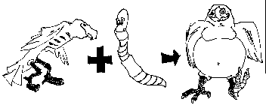
Synthesis
(Combination)

Slide 75
Types of Reactions | Definition | General Equation (Example)
Synthesis

Slide 76
Types of Reactions | Definition | General Equation (Example)
Synthesis | Two compounds combine to form a more complicated product.

Slide 77
Types of Reactions | Definition | General Equation (Example)
Synthesis | Two compounds combine to form a more complicated product. | A + B → AB 8Fe + S₈ → 8 FeS

Slide 78
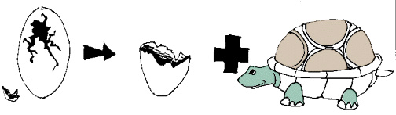
Decomposition

Slide 79
Types of Reactions | Definition | General Equation (Example)
Synthesis | Two compounds combine to form a more complicated product. | A + B → AB 8Fe + S₈ → 8 FeS
Decomposition

Slide 80
Types of Reactions | Definition | General Equation (Example)
Synthesis | Two compounds combine to form a more complicated product. | A + B → AB 8Fe + S₈ → 8 FeS
Decomposition | A complicated molecule breaks apart to form 2 simpler compounds

Slide 81
Types of Reactions | Definition | General Equation (Example)
Synthesis | Two compounds combine to form a more complicated product. | A + B → AB 8Fe + S₈ → 8 FeS
Decomposition | A complicated molecule breaks apart to form 2 simpler compounds | AB → A + B 2 H₂O → 2 H₂ + O₂

Slide 82
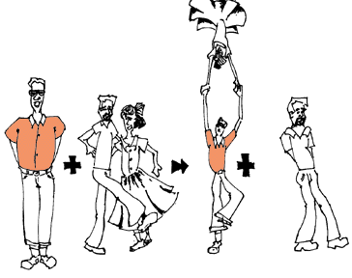
Single Replacement

Slide 83
Types of Reactions | Definition | General Equation (Example)
Synthesis | Two compounds combine to form a more complicated product. | A + B → AB 8Fe + S₈ → 8 FeS
Decomposition | A complicated molecule breaks apart to form 2 simpler compounds | AB → A + B 2 H₂O → 2 H₂ + O₂
Single Replacement

Slide 84
Types of Reactions | Definition | General Equation (Example)
Synthesis | Two compounds combine to form a more complicated product. | A + B → AB 8Fe + S₈ → 8 FeS
Decomposition | A complicated molecule breaks apart to form 2 simpler compounds | AB → A + B 2 H₂O → 2 H₂ + O₂
Single Replacement | One element trades places w/ another element in a compound

Slide 85
Types of Reactions | Definition | General Equation (Example)
Synthesis | Two compounds combine to form a more complicated product. | A + B → AB 8Fe + S₈ → 8 FeS
Decomposition | A complicated molecule breaks apart to form 2 simpler compounds | AB → A + B 2 H₂O → 2 H₂ + O₂
Single Replacement | One element trades places w/ another element in a compound | A + BC → B + AC Zn + Ag(NO₃) → 2 Ag + Zn(NO₃)₂

Slide 86
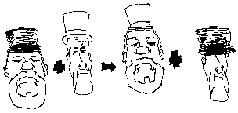
Double Replacement

Slide 87
Types of Reactions | Definition | General Equation (Example)
Synthesis | Two compounds combine to form a more complicated product. | A + B → AB 8Fe + S₈ → 8 FeS
Decomposition | A complicated molecule breaks apart to form 2 simpler compounds | AB → A + B 2 H₂O → 2 H₂ + O₂
Single Replacement | One element trades places w/ another element in a compound | A + BC → B + AC Zn + Ag(NO₃) → 2 Ag + Zn(NO₃)₂
Double Replacement

Slide 88
Types of Reactions | Definition | General Equation (Example)
Synthesis | Two compounds combine to form a more complicated product. | A + B → AB 8Fe + S₈ → 8 FeS
Decomposition | A complicated molecule breaks apart to form 2 simpler compounds | AB → A + B 2 H₂O → 2 H₂ + O₂
Single Replacement | One element trades places w/ another element in a compound | A + BC → B + AC Zn + Ag(NO₃) → 2 Ag + Zn(NO₃)₂
Double Replacement | Two elements switch places in the reactants

Slide 89
Types of Reactions | Definition | General Equation (Example)
Synthesis | Two compounds combine to form a more complicated product. | A + B → AB 8Fe + S₈ → 8 FeS
Decomposition | A complicated molecule breaks apart to form 2 simpler compounds | AB → A + B 2 H₂O → 2 H₂ + O₂
Single Replacement | One element trades places w/ another element in a compound | A + BC → B + AC Zn + Ag(NO₃) → 2 Ag + Zn(NO₃)₂
Double Replacement | Two elements switch places in the reactants | AB + CD → AD + CB Na(NO₃) + KCl → NaCl + K(NO₃)

Slide 90
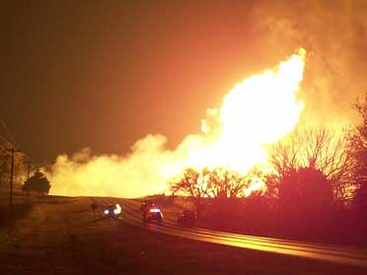
Combustion

Slide 91
Types of Reactions | Definition | General Equation (Example)
Synthesis | Two compounds combine to form a more complicated product. | A + B → AB 8Fe + S₈ → 8 FeS
Decomposition | A complicated molecule breaks apart to form 2 simpler compounds | AB → A + B 2 H₂O → 2 H₂ + O₂
Single Replacement | One element trades places w/ another element in a compound | A + BC → B + AC Zn + Ag(NO₃) → 2 Ag + Zn(NO₃)₂
Double Replacement | Two elements switch places in the reactants | AB + CD → AD + CB Na(NO₃) + KCl → NaCl + K(NO₃)
Combustion

Slide 92
Types of Reactions | Definition | General Equation (Example)
Synthesis | Two compounds combine to form a more complicated product. | A + B → AB 8Fe + S₈ → 8 FeS
Decomposition | A complicated molecule breaks apart to form 2 simpler compounds | AB → A + B 2 H₂O → 2 H₂ + O₂
Single Replacement | One element trades places w/ another element in a compound | A + BC → B + AC Zn + Ag(NO₃) → 2 Ag + Zn(NO₃)₂
Double Replacement | Two elements switch places in the reactants | AB + CD → AD + CB Na(NO₃) + KCl → NaCl + K(NO₃)
Combustion | Oxygen combines with a carbon compound to form water and carbon dioxide, CO₂

Slide 93
Types of Reactions | Definition | General Equation (Example)
Synthesis | Two compounds combine to form a more complicated product. | A + B → AB 8Fe + S₈ → 8 FeS
Decomposition | A complicated molecule breaks apart to form 2 simpler compounds | AB → A + B 2 H₂O → 2 H₂ + O₂
Single Replacement | One element trades places w/ another element in a compound | A + BC → B + AC Zn + Ag(NO₃) → 2 Ag + Zn(NO₃)₂
Double Replacement | Two elements switch places in the reactants | AB + CD → AD + CB Na(NO₃) + KCl → NaCl + K(NO₃)
Combustion | Oxygen combines with a carbon compound to form water and carbon dioxide, CO₂ | CB + O₂→ CO₂ + H₂O

Slide 94
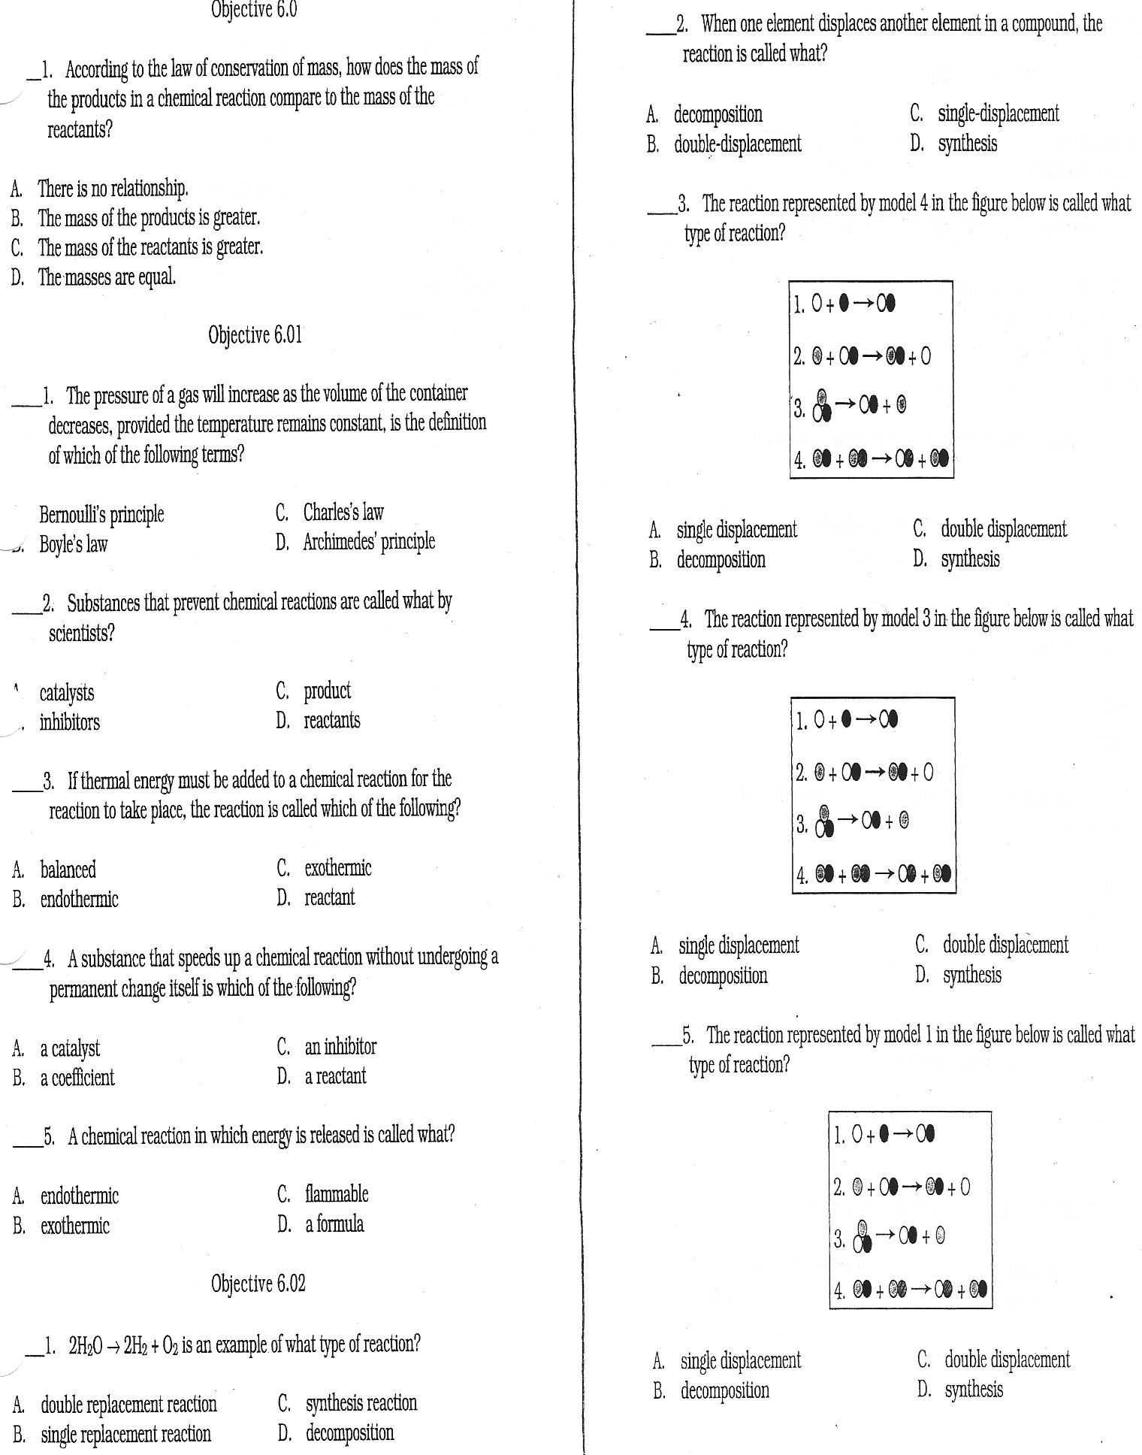
Let’s Practice !!!
Match the reactions represented in this figure with the following choices.
Decomposition Reactions
Synthesis Reactions
Double Replacement Reaction
Single Replacement Reactions

