Slide 1
Week 20 Chemistry
The Mole Concept, Unit 5 Assessment, Mole Conversions

Slide 2
Warm Up: 4 Minutes
Write the Learning Target
Sit anywhere you’d like
No more than 4 people per row
In everyday life we use counting units like the dozen (12 objects) and gross (144 objects) to deal with large quantities. In chemistry, the unit for dealing with atoms, ions, and molecules is the mole. Based on this, define the term mole in YOUR OWN WORDS.
You DO NOT have to copy the question

Slide 3
Agenda
Warm Up- 7 Minutes
Notes/Flow Chart - 15 Minutes
Guided Practice- 12 Minutes
Independent Practice- 15 Minutes
Closing – 4 Minutes

Slide 4
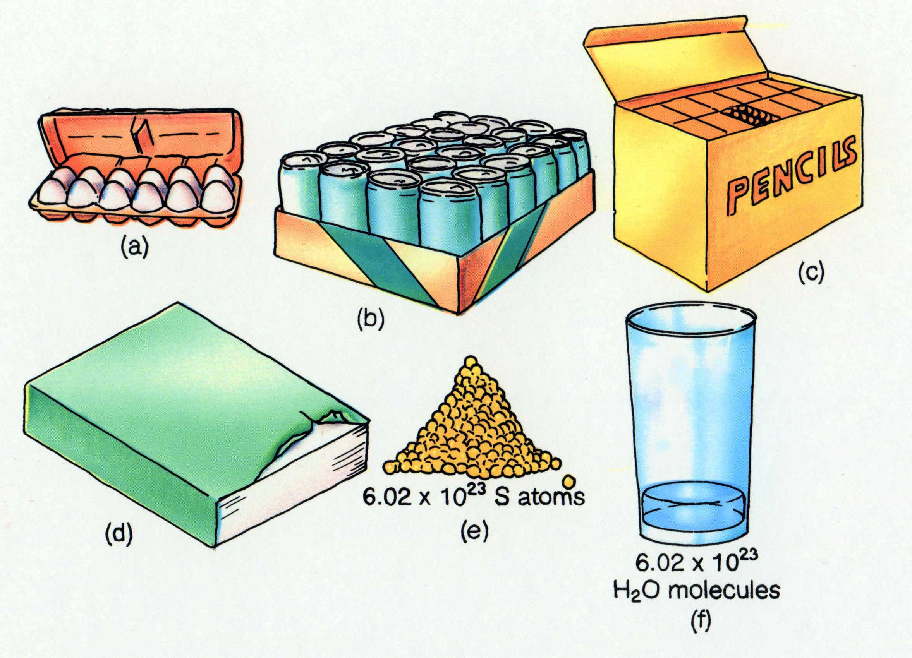
How many particles?
Timberlake, Chemistry 7th Edition, page 179

Slide 5
What is a Mole???

Slide 6
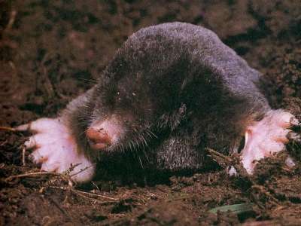
1 Mole of a Substance
6.02 x 10²³ particles (atoms, molecules or formula units)
Avogadro’s Number
Notes:
Objectives:
To state the value of Avogadro’s number: 6.02 x10²³.
To state the mass of Avogadro’s number of atoms for any element by referring to the periodic table.
To relate the moles of a substance to the number of particles.
http://www.birdxcanada.com/sonic/mole_400.jpg

Slide 7
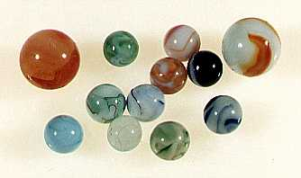
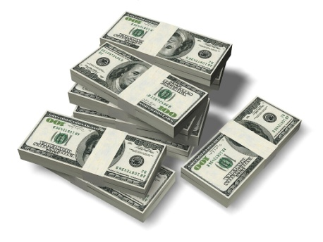
How Big is a Mole?
One mole of marbles would cover the entire Earth
(oceans included) for a depth of three miles.
One mole of $100 bills stacked one on top of another
would reach from the Sun to Pluto and back 7.5 million
times.
It would take light 9500 years to travel from the
bottom to the top of a stack of 1 mole of $1 bills.
Notes:
6.02 x 10²³ softballs = volume of Earth
6.02 x 10²³ Olympic shot puts = mass of Earth
6.02 x 10²³ atoms H laid side by side would encircle Earth ~1,000,000 times

Slide 8
Check Point #1
How many particles are in 1 mole of Copper?
6.02 x 10²³ atoms

Slide 9
Matter

Slide 10
Matter
Particles

Slide 11
What are the types of particles?

Slide 12
Matter
Particles
Atoms

Slide 13
Matter
Particles
Atoms
Molecules

Slide 14
Matter
Particles
Atoms
Molecules
Formula Units

Slide 15
Matter
Particles
Atoms
Single Element
Molecules
Formula Units

Slide 16
Matter
Particles
Atoms
Single Element
Examples: Hg, Ag, Au
Molecules
Formula Units

Slide 17
Matter
Particles
Atoms
Molecules
Covalent Compounds
Single Element
Examples: Hg, Ag, Au
Formula Units

Slide 18
Matter
Particles
Atoms
Molecules
Formula Units
Covalent Compounds
Single Element
Examples: Hg, Ag, Au
H₂, CO, CO₂

Slide 19
Matter
Particles
Atoms
Molecules
Formula Units
Ionic Compounds
Covalent Compounds
Single Element
Examples: Hg, Ag, Au
H₂, CO, CO₂

Slide 20
Matter
Particles
Atoms
Molecules
Formula Units
Ionic Compounds
Covalent Compounds
Single Element
Examples: Hg, Ag, Au
H₂, CO, CO₂
NaF, BaSO₄

Slide 21
Check Point #2
Classify the following particles as an atom, molecule, or formula units
SO₂
_{Molecule}

Slide 22
Check Point #3
Classify the following particles as an atom, molecule, or formula units
Mn
_{Atom}

Slide 23
Check Point #4
Classify the following particles as an atom, molecule, or formula units
KOH
_{Formula Unit}

Slide 24
Guided Practice
Teacher:
  1. Will show the problem on the board
Students:
  Number Paper 1-7
  Take 17 seconds to solve the problem individually.
  Take 27 seconds to speak with your shoulder partner about the problem
  Be ready to share when Mr. Ghosh says SWAG

Slide 25
Guided Practice #1
Classify the following particles as an atom, molecule, or formula units
Sodium Bromide
_{Formula Units}

Slide 26
Guided Practice #2
Classify the following particles as an atom, molecule, or formula units
Helium
_{Atoms}

Slide 27
Guided Practice #3
Classify the following particles as an atom, molecule, or formula units
Bromine, Br₂
_{Molecules}

Slide 28
Guided Practice #4
One ____ of Helium has 6.02 x 10²³ atoms.
Mole

Slide 29
Guided Practice #5
One Mole of Magnesium Chloride has _______ formula units.
6.02 x 10²³

Slide 30
Guided Practice #6
True or False
100 moles of Carbon Dioxide molecules has the same number of particles as 100 moles of Sulfur atoms . _________________
True

Slide 31
Guided Practice #7
True or False
40 moles of SO₂ molecules has the same number of atoms as 50 moles of Sulfur ·_________________
False

Slide 32
Independent Practice
85%
Practice makes Perfect

Slide 33
Closing
What are the three types of particles?
A mole of a substance is equal to how many particles ________.

Slide 34
Warm Up: 4 Minutes
Write the Learning Target
Stay in your own seat
You should be working SILENTLY
  Convert 312.4 megameters to meters. Express your answer using scientific notation

Slide 35
Agenda
Warm Up- 7 Minutes
Purpose of Review/ Material Covered- 3 Minutes
Expectations for White Board Jeopardy- 3 Minutes
White Board Jeopardy- 37 Minutes
Closing- 3 Minutes

Slide 36
Purpose of Reviewing
Prepare for Assessment 5

Slide 37
Why Prepare?
85%
18
Questions

Slide 38
Material Covered on Assessment 5
Lewis Dot Structures
VSEPR Structures (shapes chart is NOT going to be given to you)
Significant Figures
Scientific Notation
Dimensional Analysis (prefix chart is NOT going to be given to you)
The Mole

Slide 39
White Board Jeopardy
Students will work in groups of 3 to 4 (Team number is on the desk in front of you).
Students will need Dry Erase Board, Marker, Periodic Table, Nomenclature Sheet, and Eraser.
NOTES are allowed during White Board Jeopardy

Slide 40

White Board Jeopardy
Team #
How to Play???
Write your team number in the upper right hand corner
During the song, you will work the problem shown in your lap INDIVIDUALLY.
At the end of the Jeopardy song, you will talk with your group.
When Mr. Ghosh says “Boards Up” , all students in group must have Identical responses on their Dry Erase Boards that are correct in order to receive FULL CREDIT. Boards that are not up will not be counted.
You may be called on randomly to explain your answer. If I do this and you cannot explain correctly, your team will NOT receive credit.

Slide 41
Scoring and Rules/Expectations
Scoring:
All questions are worth 1 point
Rules/Expectations:
No talking during the Jeopardy song
Must be working individually during the song
No arguing with Mr. Ghosh about scoring
Must be explaining WHY during group work time
Any violations of the rules/expectations will result in your team losing a point

Slide 42
Prizes!
The team that finishes with the most number of points will receive 5% extra credit on the Exam tomorrow.

Slide 43

Draw the Lewis Dot Structure for NH₃

Slide 44
What is the molecular structure of Hydrogen Cyanide (HCN)
  Linear
  Trigonal Planar
  Tetrahedral
  Trigonal Pyramidal

Slide 45
Convert 6.22 grams to milligrams

Slide 46
1 mole of Sodium Bromide contains 6.02 x 10²³ ________

Slide 47
Draw the Lewis Dot Structure for Hydrogen Chloride (HCl)

Slide 48
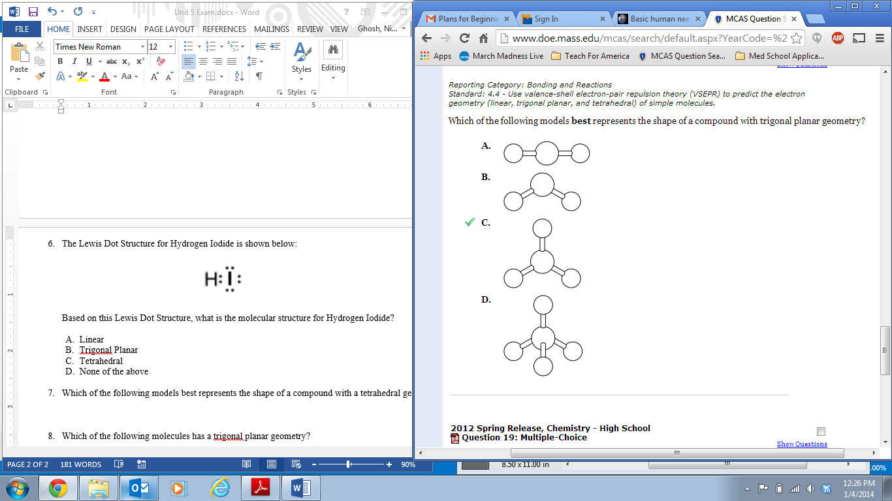
Which of the following models best represents the shape of a compound with a trigonal planar geometry?

Slide 49
Express 64800 meters in scientific notation

Slide 50
1 mole of Carbon contains 6.02 x 10²³ ________

Slide 51
Draw the Lewis Dot Structure for HCN

Slide 52
Which of the following molecules has a bent geometry?
  Silicon Dioxide, SiO₂
  Carbon Tetrachloride, CCl₄
  Water, H₂O
  Nitrogen Trichloride, NCl₃

Slide 53
Express 3.15 x 10⁻⁴ grams in standard notation

Slide 54
How many particles are in 1 mole of Al₆O₁₈(OH)₃F?

Slide 55
Draw the Lewis Dot Structure for Cl₂CO

Slide 56
Which molecular structure has 3 bonding atoms and 1 lone pair on the central atom?
  Linear
  Bent
  Tetrahedral
  Trigonal Pyramidal

Slide 57
Express 1.16 x 10⁻⁷ Joules in standard notation

Slide 58
What is true about one mole of anything?

Slide 59
Closing
Good Luck
Studying

